Slide 1




Niagara Crisis Guideline Launch

Slide 2
Agenda
Welcome & Outcomes
Niagara Service Delivery Network & History of the Development of the Crisis Protocol
Community Partners
Niagara Crisis Guideline: Overview
Refreshment Break
Developing a Crisis Plan
Resources
Closing Remarks & Evaluation
Notes:
Kelly & Sarina
Talking Points:
Recognize Sam Curtin MCSS (provided funding for Crisis Guideline Launch and Implementation)
Show of hands from all the sectors participating in Launch: Community Mental Health, Hospital, Community Health Centres, Developmental Service Sector, Seniors Sector, COAST, Justice, others??
Highlight that the main purpose of Crisis Guideline is to recognize that we can support people a lot better when we work together!
- Reflect on the growth in Niagara’s capacity to respond to people in crisis: CIT Trained officers, COAST, Safe Beds, and over the summer the Mobile Crisis Rapid Response Team

Slide 3
Community Crisis Guidelines
Crisis Guidelines are agreements among community service providers and emergency services to implement and evaluate practices and processes that reduce the intensity and frequency of individual crises in the community.
Notes:
Tom & Liz

Slide 4
Elements of Success
Participation of organizations who support individuals more likely to experience crisis
Agreement among organizations regarding roles and responsibilities responding to crisis
Development and maintenance of Individualized Crisis Plans with those most likely to experience a crisis
Communication, collaboration among key organizations
Notes:
Tom & Liz

Slide 5
Niagara’s Crisis Guideline
Developed by Niagara’s Developmental Services sector, Mental Health and Addictions sector, COAST Niagara, Niagara Regional Police Services, & Niagara Health System.
Focused on individuals with one or more difficulties with mental health disorders, addictions, acquired brain injury and / or developmental disabilities.
Notes:
Kelly & Sarina:
Talking Points:
Show of hands for people involved in NSDN
Show of hands for people who have ben involved in the many years of birthing the guideline.
Identify that this is the latest version of the Guideline. Changes were for a good reason – discussions, programs and services have evolved over the past 6 months.

Slide 6
Community Preparation
Organizations will ensure that staff are familiar with social services and emergency services
Organizations will provide training to emergency services on the population they support
Organizations and Emergency Services will ensure that staff are familiar with their responsibilities under the Crisis Guideline
Notes:
Kelly & Sarina
Key talking points:
Today’s launch is a great opportunity for us to work on these items – please use the break to introduce yourself to someone new, find out what they do and how they might help and how you can help them – exchange business cards!!!!

Slide 7
Crisis Planning
Organizations will encourage staff to develop, share and maintain a Crisis Plan with individuals they support
Organizations will participate in the development and maintenance of Crisis Plans when invited
Organizations will *fax Crisis Plans with COAST Niagara & NHS Psychiatric Emergency Response Team (PERT)
Crisis Plans will be updated at least annually
Organizations will use the Crisis Plan when concerns escalate
Notes:
Kelly & Sarina
Talking Points:
* Asterisk = With the informed consents from Individual or their guardian or Substitute Decision Maker

Slide 8
Organization Roles – Niagara Regional Police Services
Respond to 911 requests
If Mobile Crisis Rapid Response Team (MCRRT) responds, they will *access Crisis Plan directly
MCRRT will utilize strategies from Crisis Plan when responding to request
If appropriate, transport individual to NHS Emergency Services or CMHA Safe Beds as an alternative
Notes:
Laura Bruno is a mental health worker with both COAST and MCRRT
Talking Points:
Describe CIT and is success (what it is, Officers volunteer to be trained, that it is Ontario wide, how long it has been in place in Niagara, how many officers get trained each year, how many may be on at any one shift….)
Describe MCRRT (when it started, what it entails, any successes [stats], hours of operation)
Suggest that people identify a mental health or behaviour concern and ask for MCRRT or CIT when appropriate.

Slide 9
Organization Roles – COAST
*Store and reference Crisis Plans
Respond to crisis concerns
Utilize Crisis Plan during response
Assess, triage and respond to crisis:
  Phone de-escalation
  Build safety plan
  Refer to other community services
  Mobile intervention
Provide follow-up, post-crisis telephone support as appropriate
Notes:
Vanessa Blair is a COAST officer
Talking points:
Describe COAST (who is on the team, hours of operation, Stats, when it started in Niagara)

Slide 10
Organization Roles –
Niagara Health system
PERT will *store and reference Crisis Plans
Emergency Department (ED) will assess individual and triage for medical /psychiatric concerns
If psychiatric concerns, Psychiatric Emergency Response Team (PERT) will assess further.
ED and PERT will *review the Priority Community Referral and Crisis Plan and consult with service providers / care providers during assessments
PERT *will initiate referrals to service providers as appropriate
Notes:
Shaun or Ian or Kim
Talking points:
Great opportunity to highlight efforts and successes of working closely with community based agencies to improve patient experience
Highlight the importance of ED triage to rule out physical biological factors playing into emotional / behavioural mental health distress.
Describe Priority Community Referral and where to get templates
Describe how Crisis Plan and PCR is helpful to assessment and stabalization

Slide 11
What to bring to NHS ED
Priority Community Referral (fax ahead)
Crisis Plan
Medication List
OHIP Card
Money (parking, snacks, pay phone, taxi…)
Calming items (blankets, squeeze balls, earplugs, iPads, sunglasses…)
Cell phone
Food and Drink
Something to occupy time while waiting
Notes:
Shaun or Ian or Kim

Slide 12
Organization Roles – CMHA Safe Beds
CMHA will participate in Crisis Plan development as appropriate
CMHA Safe Beds Program will provide short term residential care/stay as appropriate
CMHA Safe Beds will assess the individuals need and their capacity to meet the need
CMHA Safe Beds will work with COAST and service providers to *initiate additional referrals as appropriate
Notes:
Kelly
Key points:
Describe Safe Beds
Describe partnership that allows a Bethesda Behaviour Therapist to support users – perhaps talk about how the model is being seen as a good example by other LHIN’s
Describe when / how safebeds may be a better option than ED

Slide 13
Sector Roles – Residential Providers
Complete and * fax Crisis Plans to COAST, PERT and other involved providers
Use strategies in the Crisis Plan to de-escalate potential crisis and respond to crisis
*Ensure Crisis Plans are updated, at least yearly
Ensure Priority Community Referral, Crisis Plans, medication sheets and other relevant documents are shared with NHS ED & PERT
Accompany individual to NHS / CMHA Safe Beds
Offer assistance to NHS / Safe Beds in supporting the individual
Notes:
Sarina or Kelly

Slide 14
Sector Roles – Non-Residential Supports
Assist with Crisis Plan development and implementation
Ensure Crisis Plans are *faxed to COAST, PERT and other involved providers
Use strategies in the Crisis Plan to de-escalate potential crisis and respond to crises
Ensure Crisis Plans are updated, at least yearly
Encourage individual and supports to bring Crisis Plan, medication list, and other relevant documents to NHS ED / Safe beds
Notes:
Tom
Key points:
Many people do not live in residential supports, but still need help.

Slide 15
Post Crisis
Individual and support team evaluate the effectiveness of Crisis Plan
Crisis Plans are updated and *shared as appropriate (at least annually)
*Referrals for developmental services are directed to Developmental Services Ontario (DSO)
*Referrals for mental health services are directed to Mental Health and Addictions Action Line
Identified gaps in services and supports are shared with Niagara Service Delivery Network
Notes:
Tom?

Slide 16
Refreshment Break
Notes:
Terry

Slide 17

Notes:
Terry

Slide 18
Crisis Plans - What
Agreements by the individual, their friends/family, & service organizations on how to identify and respond to pre-crisis, crisis and post crisis behaviour.
List stressors / triggers and things that should be reduced prior to and during a crisis
List de-escalation strategies that should be increased prior to and during a crisis.
Documented and shared so that they can be referenced during times of stress and confusion.
Notes:
Tom
Key Points:
Crisis Plans or Crisis Prevention Plans?
Individual has to be at the centre of the discussion / plan.
Most people have times when they can be involved in discussions about avoiding situations when the say and do thinks they feel awful about.
I have been at Crisis planning meetings where the person worked on a jigsaw puzzle beside us and would join in with thoughts and suggestions – we need to listen!

Slide 19
Crisis Plans – Why & When
Crisis Plans reduce the number and intensity of crises
Crisis Plans should be developed when there is a risk of a recurrence of a crisis – responses to future crises should be proactive and predictable, not reactive.
Crisis Plans should be reviewed and updated after each crisis and annually.
Notes:
Tom

Slide 20
Crisis Plans – Elements for Success
Involvement and agreement of individual
Involvement of people who now the person & may be present during the crisis
Involvement of service organizations who are involved and have an identified role in responding to the crisis
Identification of a lead case manager / coordinator / communicator
Regular review and updating
All parties have access to current Crisis Plan
Notes:
Tom

Slide 21
Crisis Plans – Working as a team
BSO has implemented an Integrated Community Lead model
Involvement of people from multiple sectors and organization
Clear identification of “Lead” for plan
Regular review and updating
Benefits of approach
Lessons learned to implement the development of crisis plans
Notes:
Mainly Kathy Peters, Kelly to add to last point about lessons learned.

Slide 22
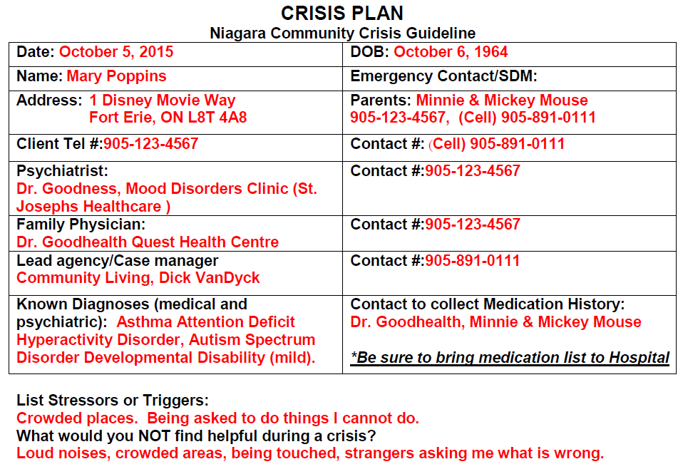
Notes:
Tom:
Scenario is based on several elements from a crisis planning meetings.
Set the scene. Meet with individual and discuss situations that led to crisis (ED, Police, EMS). Got OK to bring some of her supports (paid, unpaid) together to help reduce crisis in her life. Discussed things that she felt important in plan that shouldn’t be forgotten.
We have all been involved in helping people who experience crisis, so we want you to speak up and share. 4 potted mums have to go home with keeners!
First section is very important but boring. COAST and NHS PERT need list of stressors and things that are not helpful. COAST will be entering the information you provide up front on their data base.
Can I hear about anyone’s experience with unusual things that may get a person even more reactive???
What we will / should discover is that people will have different triggers, stressors, and calming strategies – very unique. They may not know why different things set them off or calm them. For Crisis plan purposes we don’t need to know why they have them, just to avoid them or re-enforce them.

Slide 23
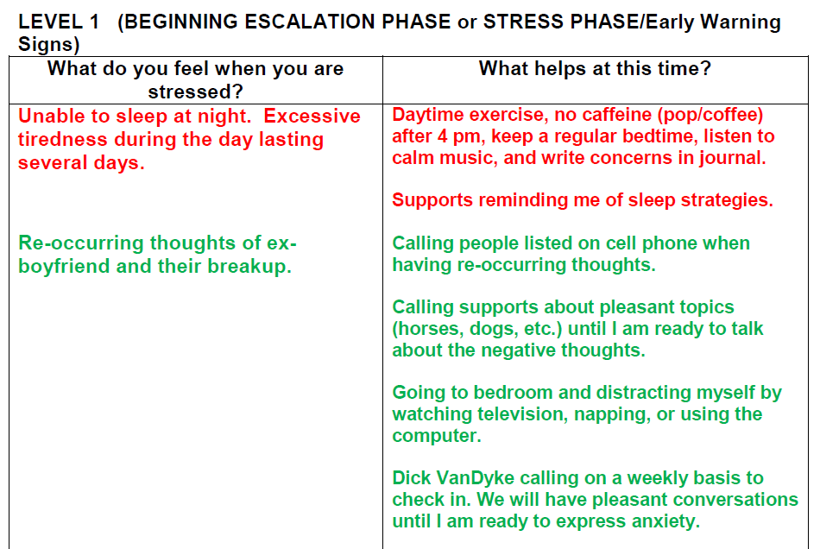
Notes:
Kelly
Anyone know about sleep strategies that work for other people?
Anyone know of strategies to address re-occurring sad thoughts?

Slide 24
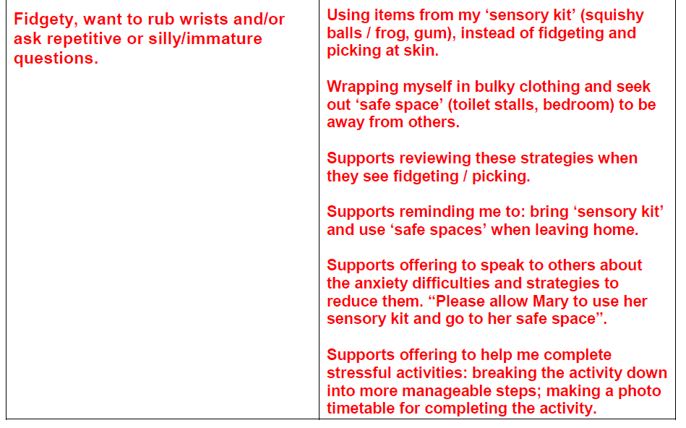
Notes:
Kelly

Slide 25
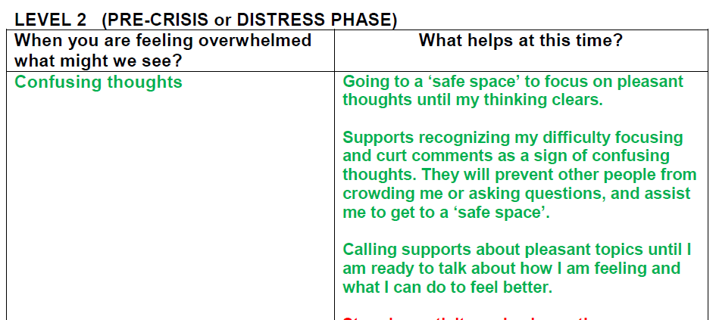
Notes:
Kelly
Notice that as the emotions escalate, there is more of a role in supports to do something that the person may no longer be able to do for them selves. Prevent others from crowding, assist her to a safe place

Slide 26
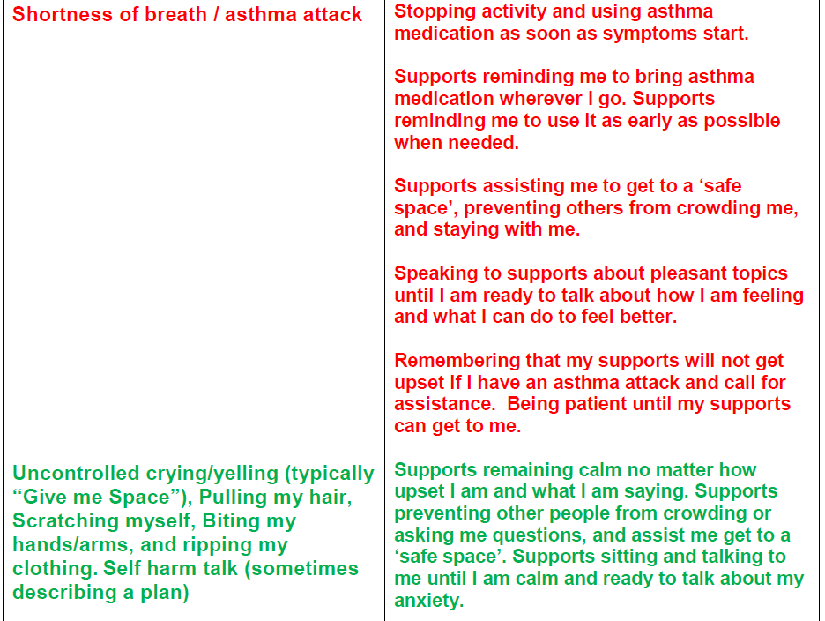
Notes:
Kelly

Slide 27
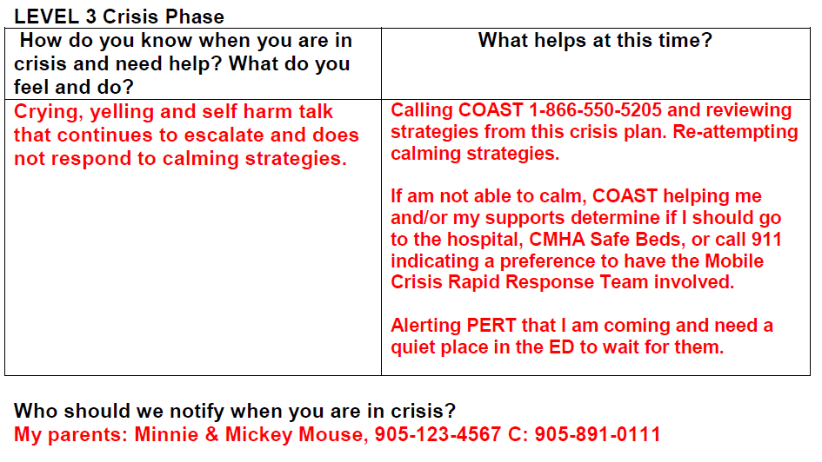
Notes:
Kelly
Level 3 is when calming / redirect strategies are no longer working.

Slide 28
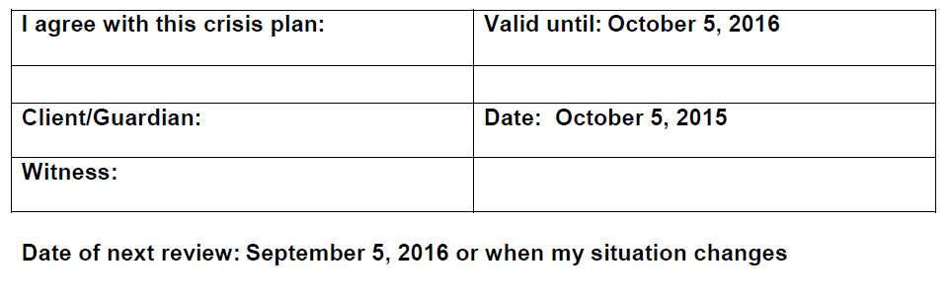
Notes:
Kelly
Individual needs to agree for it to work . The value of verbal and written contracts

Slide 29
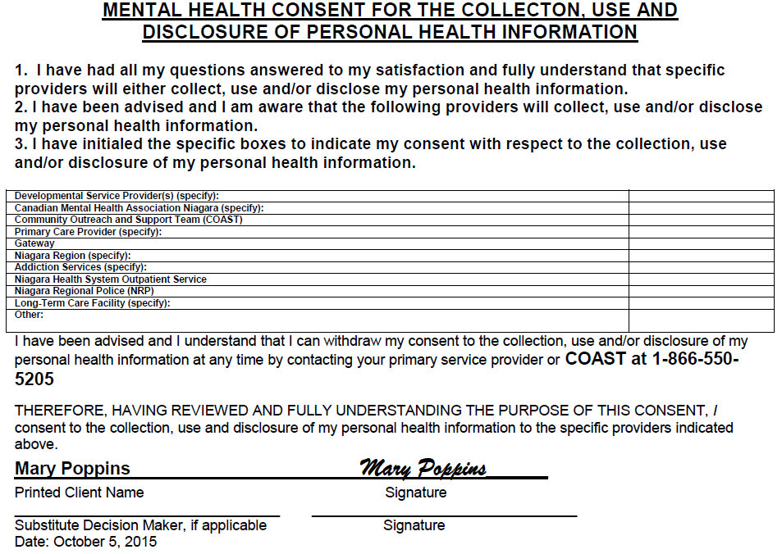
Notes:
Kelly
Sharing with others is a key element in crisis response
Template has COAST, NHS enbedded. Other organizations and people (family, friends, neighbours) can also be added.
Individual can decide who not to share it with
Individual can withdraw consent to one or more at any time

Slide 30
Closing Remarks
Notes:
Kelly and Sarina
Thank You
Evaluations

