Slide 1


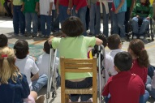


______________________________________ ____
___________________________________________
The Real Stories; Research that Draws and Talks.
Sharing the journey toward co-authorship & accessible research through art and other media.
Presented by:
Sue Hutton
Peter Park
October 2, 2017

Slide 2
ARCH Disability Law Centre
Specialty legal aid clinic dedicated to defending and advancing human rights and equality rights of persons with disabilities in Ontario.
Governed by a volunteer board of directors, a majority of whom are people with disabilities.
Offer summary legal advice and referrals to Ontarians with disabilities; represent individuals as well as provincial and national disability organizations in test case litigation at all levels of tribunals and courts, including the Supreme Court of Canada;
Provide education to people with disabilities on disability rights, and to the legal profession about disability law; make submissions on matters of policy and law reform.
More details on ARCH’s website at: www.archdisabilitylaw.ca

Slide 3
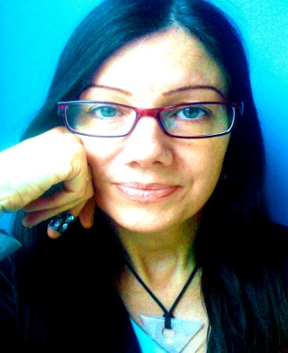
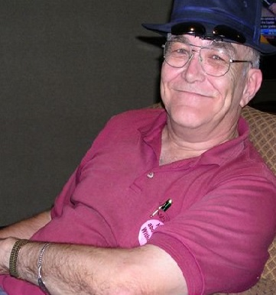
Today`s Presenters
Sue Peter
Hutton Park
Notes:
-the perspective of ARCH is based on our work with individual persons labelled with intellectual disabilities and with our advocacy project called Respecting Rights. we want to tell you a little bit about Respecting Rights.

Slide 4
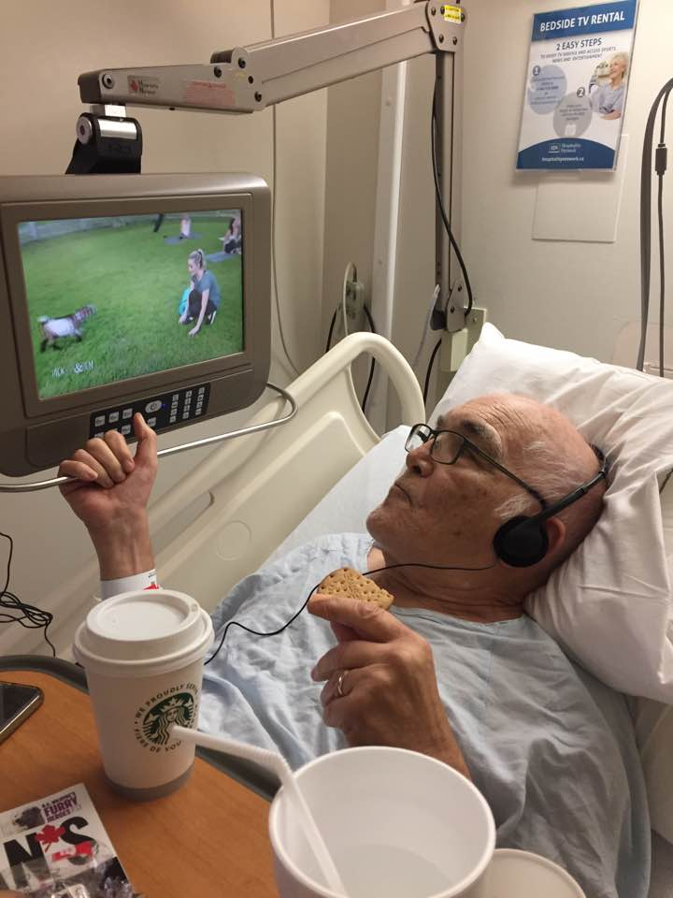
I would be there if I could!

Slide 5
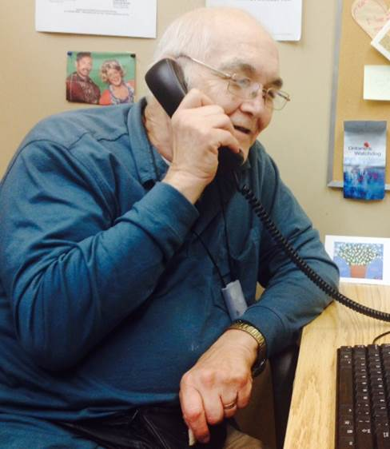
Video Clip of Peter

Slide 6

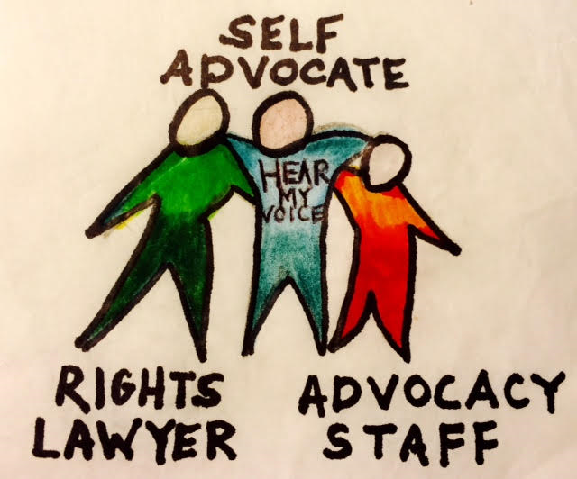
Respecting Rights
Project at ARCH promoting and advancing the rights of persons labelled with intellectual disabilities in Ontario

Slide 7
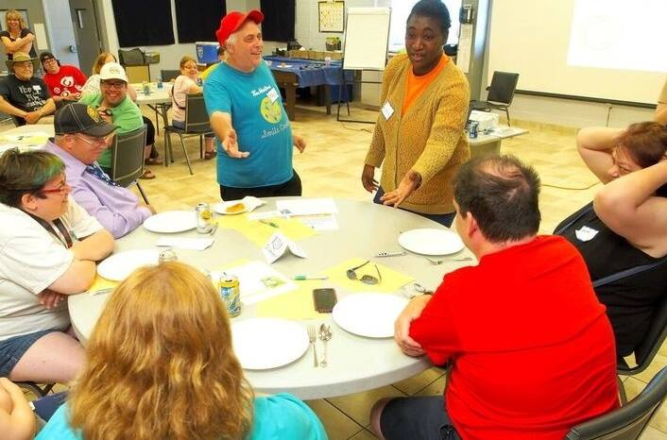
Respecting Rights
Legal education workshops for persons labelled with intellectual disabilities, their families and staff

Slide 8
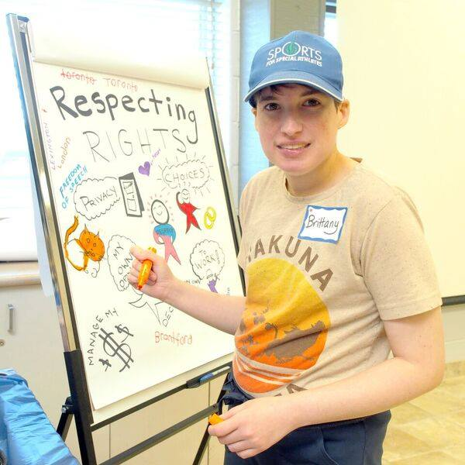
Rights education through art

Slide 9
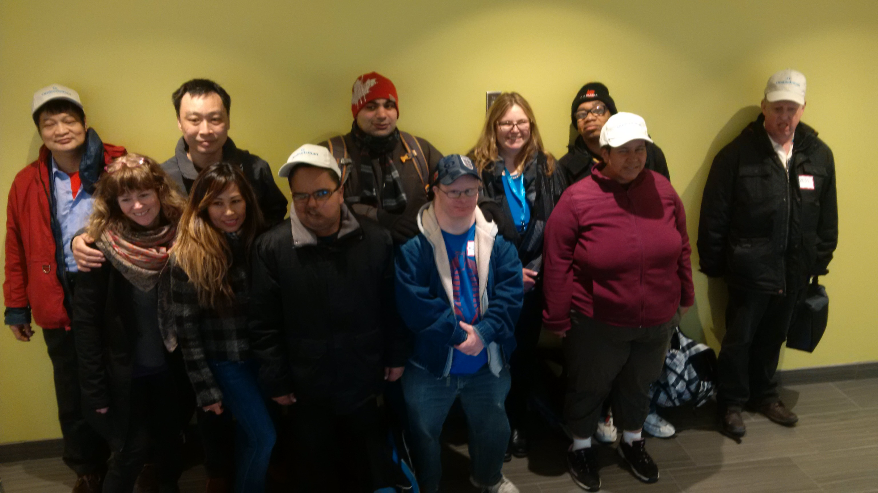
Inclusive Law Reform Ombudsman’s Office

Slide 10
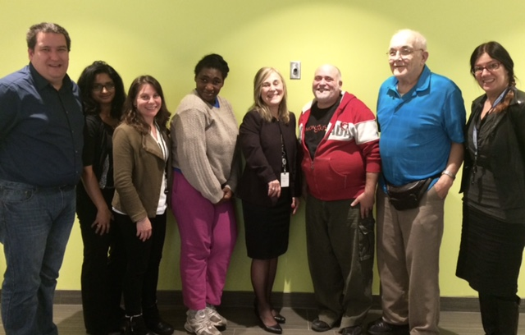
Plain language meetings with MCSS

Slide 11
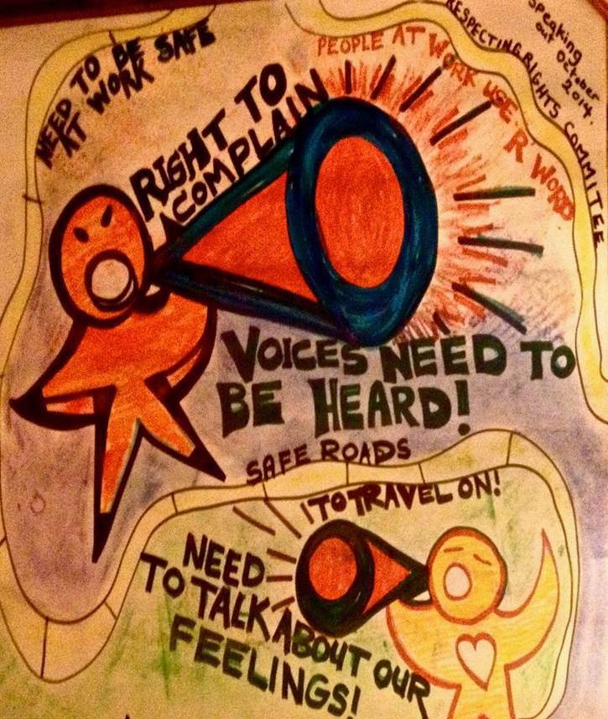
Minutes Taken with Graphic Recording

Slide 12
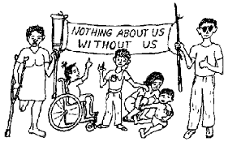
Nothing About Us Without Us
Peter:
It seems that very few researchers recognize people with disabilities other than as research subjects.
We are just “data”
Notes:
1978 – the People First Book
One of the PF members said this
It’s still true today

Slide 13
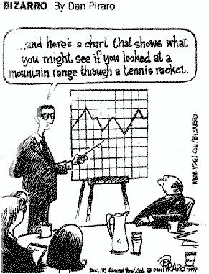

Slide 14
Peter Park
Institutionalized at age of 20 with epilepsy
Got out 18 years later and immediately founded People First of Ontario
Known as the Godfather of self-advocacy

Slide 15
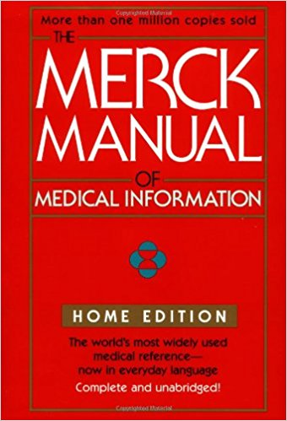
Peter’s Background and Interest in Research
My dad was a pharmacist
I had the Merck Manual in the institution.
I knew I was a guinea pig with no consent
Notes:
Was always interested in science, given the CPS and interest in medication side effects for epilepsy

Slide 16

Peter’s Research
JODD Challenges in Self-Advocacy (2011)
CJDS – Self Advocacy from the Ashes (2017)
Marcia Rioux & Mary Ann Burke collaborations 1990’s.
Plain Language
Translation MCSS

Slide 17
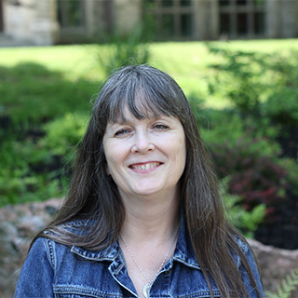
Research and Inclusive Practice
People labelled with intellectual disabilities have had little or no involvement in how they are known.
(Shormans, A. 2011)

Slide 18
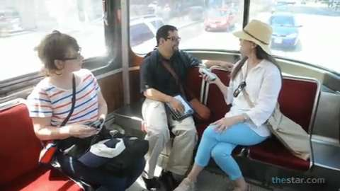
My Life in the City Drama & GPS for Qualitative Data Collection
Using theatre, GPS and Geographic Information System technology, voice recordings and iPads
(Shormans, A. 2011)
Notes:
Studied 12 people moving around city.

Slide 19
Enabling people to tell their own stories
Let’s create:
…a kind of research which enables people to communicate, in a meaningful way, about their identities and experiences, and their own thoughts about their identities and experiences, through creatively making things themselves.
Gauntlett, D., & Holzwarth, P. (2006).

Slide 20

Paulo Friere Involve the “Oppressed” as Co-creators
“Swimming in the Cultural Waters of the People”
He argued for pedagogy to treat the learner as a co-creator of knowledge
(Friere, P. 1968)
Notes:
Brazilian Educator in early 1900’s.

Slide 21
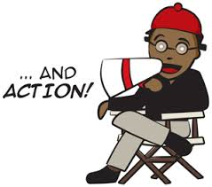
Get Creative! Partner with Drama Coaches
Participatory Theatre for data collection as well as dissemination. Ester Ignati.
Aiding Dramatic Change in Development (ADCID) – a non-profit that uses theatre for capacity building. Partnered with McMaster.
Notes:
Aiding Dramatic Change in Development (ADCID) is a non-profit organization that uses participatory theatre, art and dialogue processes. We design and implement the development of innovative community mobilisation initiatives.
Aiding Dramatic Change in Development (ADCID) works with organisations at local level, using a capacity building approach, to deal with highly contextual situations. We adhere to Paulo Friere’s belief of “swimming in the cultural waters of the people” working from within the community and using community members’ own life experiences to guide sustainable development.

Slide 22
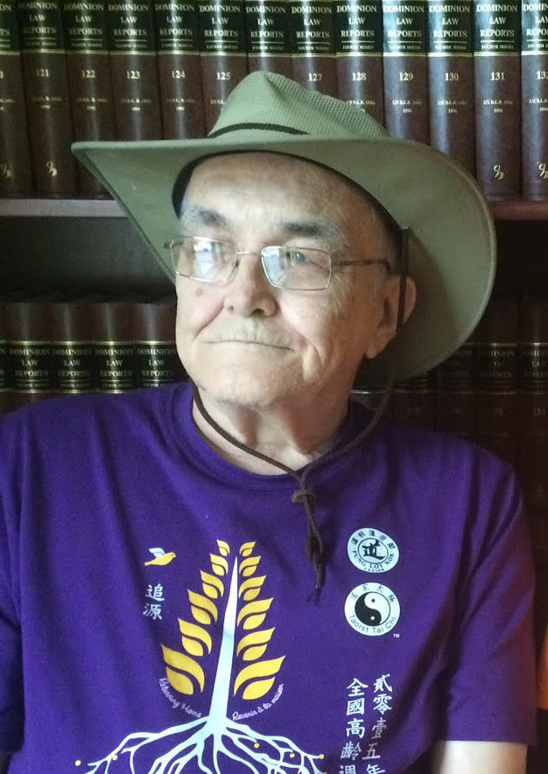
Peter Park on Research
Research is usually done TO us
We are researched to death
People who are researchers get grants and get paid to do something at our expense
No-one bothers to tell us how it’s helping and if it’s helping

Slide 23
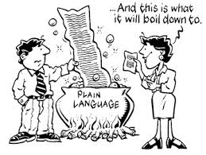
Ethics and practicing Co-authorship
Plain Language
Informed Consent
Participatory Methodologies
Alternative data collection = art, film
Dissemination – role plays
Notes:
particularly participatory and inclusive research methodologies (notably for individuals with disabilities who do not speak), and how arts-informed methodologies can facilitate inclusion.

Slide 24
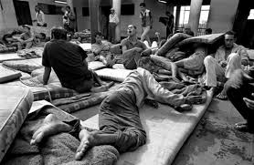
A picture is worth a thousand words

Slide 25
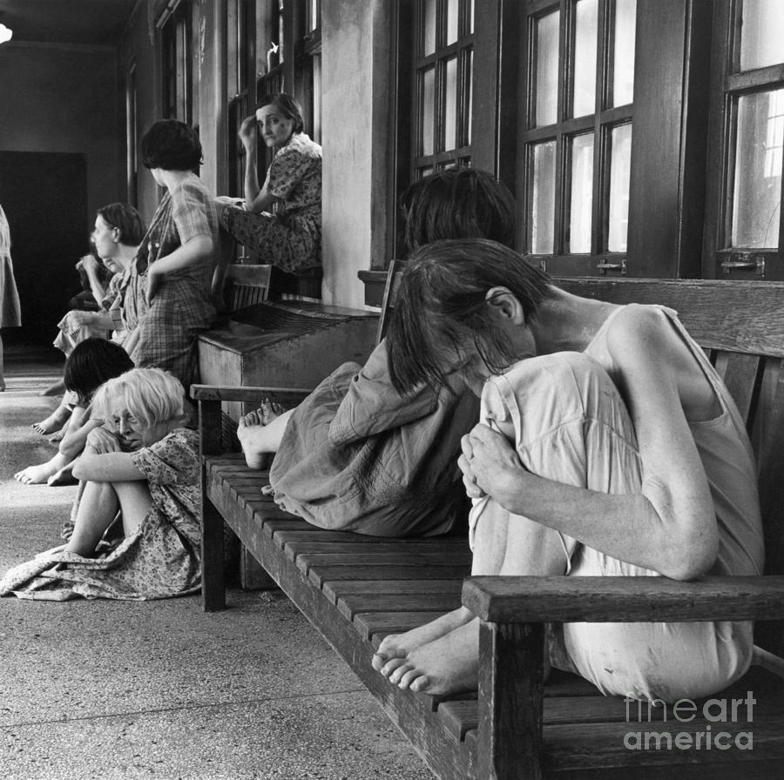
Graphic data can convey what goes beyond words

Slide 26
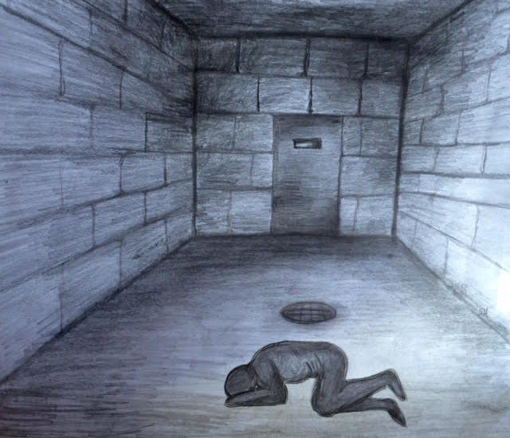
Graphic Data Collection D Ward

Slide 27
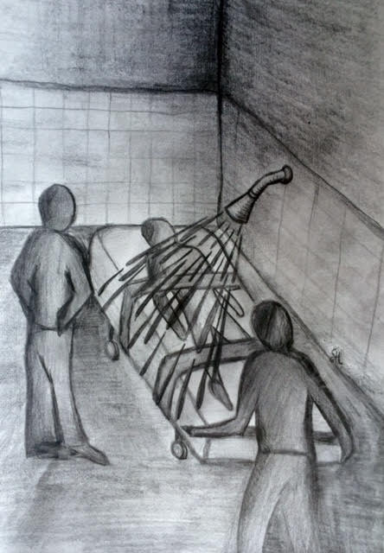
Graphic Data Collection Water Torture

Slide 28
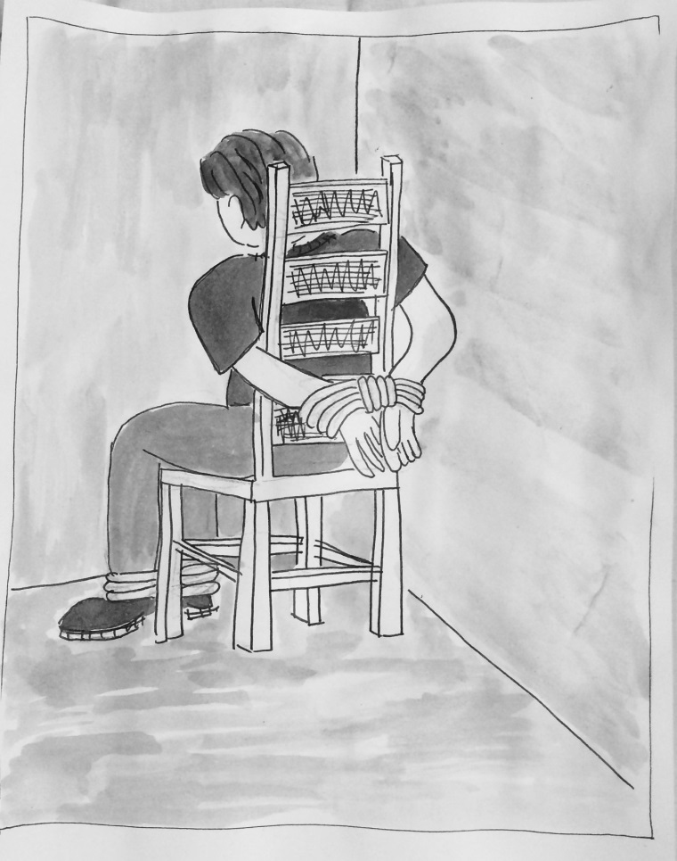
Graphic Data Collection Co-creation

Slide 29
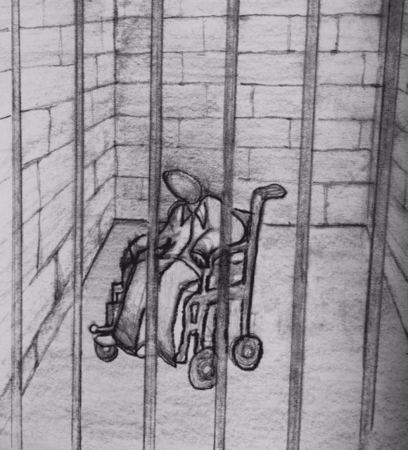
Graphic Data Collection Transition Aged Youth - Trapped

Slide 30

Informed Consent ?
How do we know
we have it
Ethics Review Boards require us to be clear about decision making and capacity and consent

Slide 31
Legal Capacity, Consent and Autonomy
Legal capacity = power provided by law to make decisions, enter into contracts, take legal action, etc.
The ability to make decisions for one’s self is an important part of autonomy and human dignity.
A person’s right to make decisions should be promoted and protected to fullest extent possible - even if it is inconvenient or challenging to do so.
Notes:
-autonomy means having independence or freedom
-starting with the premise that ability to make decisions for one’s self is an important element of autonomy and human dignity.
-therefore a person’s right to make decisions should be promoted and protected to fullest extent possible - even if it is inconvenient or challenging to do so.
-these ideas are philosophical but are also recognized by law, as we will see today

Slide 32
Ontario Law: Presumption of Capacity
In Ontario all adults are considered mentally capable of making decisions affecting them unless there is clear evidence to the contrary
A person who is 18 or older is presumed capable of entering into a contract
Substitute Decisions Act, s.2
A person who is 16 or older is presumed capable of giving or refusing consent regarding personal care (health care, nutrition, shelter, clothing, hygiene, safety)
Substitute Decisions Act, s.2
Notes:
-first bullet: this includes people with disabilties
-personal care includes health care, nutrition, shelter, clothing, hygiene, safety

Slide 33

Dissemination How inclusive is yours?
Who do you make sure knows about your research?
Funders, academics, or people who’s lives are directly affected?
Is it plain language?
Is it available in video?

Slide 34

Group Work How can you practice inclusive research
What can you do to include people labelled with an intellectual disability in your research, in your practice
-In developing questions
-In Methodology
-In Dissemination
-Data Collection
-Plain Language

Slide 35
References
Freire, P. (2000). Pedagogy of the oppressed (30th anniversary ed.). New York: Continuum. Chicago Style
Gauntlett, D., & Holzwarth, P. (2006). Creative and visual methods for exploring identities. Visual Studies, 21(1), 82–91.
Hutton, S., Park, Levine, Johnson & Bramesfield. (2017) Self-advocacy from the ashes of the institution. Canadian Journal on Disability Studies.
Shorman, A. (2011) The Right or Responsibility of Inspection: Social Work, Photography, and People with Intellectual Disabilities. A doctoral dissertation. University of Toronto School of Social Work.
Substitute Decisions Act, 1992, SO 1992, c. 30 - Ontario.ca
https://www.ontario.ca/laws/statute/92s30
UN General Assembly (2006) Convention on the Rights of Persons with Disabilities A/RES/61/106/Annex I. Retrieved from: www.internationaldisabilityalliance.org/CRPD
Gauntlett, D., & Holzwarth, P. (2006). Creative and visual methods for exploring identities. Visual Studies, 21(1), 82–91.

Slide 36
Thank You!
ARCH Disability Law Centre
www.archdisabilitylaw.ca
Sue Hutton 416-482-8255 x 2227
huttons at lao.on.ca
or 1-866-482-2724
TTY: 416-482-1254 or 1-866-482-2728
Fax: 416-482-2981 or 1-866-881-2723
The information provided in these presentation materials is not intended to be legal advice. Consult a lawyer or legal worker if you need legal advice on a specific matter. The information in the presentation materials are current as of the date of the presentation.

