Slide 1
Strongest Families™: FASD
Parent training for challenging behaviour in children with FASD
Dr. Courtney Green, Manager of Research Development,
CanFASD Research Network
Dr. Amy Hewitt, Research Associate
Queen’s University

Slide 2
Outline
Project Overview
Data from Stakeholder Interviews
Modules for IRIS
Usability Study
Randomized Controlled Trial (RCT)

Slide 3
Outline
Project Overview
Data from Stakeholder Interviews
Modules for IRIS
Usability Study
RCT

Slide 4
We hypothesize that:
a FASD-specific parent/guardian training intervention can be developed using input from major stakeholders to meet the current limitations in access for families seeking services and supports; and
this intervention and its evaluation will provide evidence for feasibility and efficacy to support changes in policy by key decision-makers and provide the basis for developing promising practices in the area of interventions for families affected by FASD.

Slide 5
Objectives
Develop an Internet-based intervention program for parents/guardians of children with FASD between the ages of 4-12 years that is based on information collected from stakeholder interviews;
Evaluate the feasibility (usability) of the intervention; and
Obtain data on outcome measures related to child behaviour and parental mood.
Notes:
1. (e.g., parents/guardians, clinicians, decision-makers, community-based organizations

Slide 6
Proposed Studies
Study 1: To determine the behavioural and emotional problems affecting children with FASD challenges.
Telephone Surveys
~ 100 parent/caregivers
~ 30 clinicians
Study 2: To develop the text content for the Strongest Families™: FASD program.
Feasibility study
~ 30 families and 10 clinicians
Study 3: To evaluate the Strongest Families™: FASD using a RCT.
~200 families
Strongest Families: FASD or resource webpage

Slide 7
Proposed Studies
Study 1: To determine the behavioural and emotional problems affecting children with FASD challenges.
Telephone Surveys
~ 100 parent/caregivers
~ 30 clinicians
Study 2: To develop the text content for the Strongest Families™: FASD program.
Feasibility study
~ 30 families and 10 clinicians
Study 3: To evaluate the Strongest Families™: FASD using a RCT.
~200 families
Strongest Families: FASD or resource webpage

Slide 8
Study 1 Design
Parent/Guardian
Clinician
Consent
IFB
CES-D
Consent
IFB
Demographics
Additional Ques
CBCL
Demographics
Additional Ques

Slide 9
Additional Demographics
Parent/Caregiver | Child | Clinician
Age | Age | Job Title/Role
Marital Status | Sex | # years in FASD field
Highest level of educ. | Ethnicity | Age ranges diagnose
Occupation | Co-morbidities | FASD Training
Relationship to child | Age of FASD diagnosis
# Children (at home) | # Foster placements
# Children with FASD
Mo/Yr of guardianship
# Children fostered (with FASD)

Slide 10
Outcome Measures
The Child Behavior Checklist (CBCL) (Achenbach & Edelbrock, 1983)
The most widely used measure of child behaviour
It is used to ask specific questions pertaining to behavior and mental health
The Center for Epidemiologic Studies Depression Scale (CES-D) (Radloff, 1977)
20-item self report depression scale used for research in the general adult population
The Information on FASD Behaviors (IFB)
Author developed
Set of open ended questions

Slide 11
Outline
Project Overview
Data from Stakeholder Interviews
Modules for IRIS
Usability Study
RCT

Slide 12
Outline
Project Overview
Data from Stakeholder Interviews
Caregivers/Parents
Modules for IRIS
Usability Study
RCT

Slide 13
Recruitment Totals: Parent/Caregiver
69 Interested participants
41 CBCL
6 no response
3 child too old
60 Interviews Complete
52 CES-D
52 Demo Info
60 Data Sets

Slide 14
Parent/Caregiver Demographics
Respondents
47 (90.4%) Female
5 (9.6%) Male
Age of primary caregiver
20-29 y: 1(1.9%)
30-39 y: 9(17.3%)
40-49 y: 21 (40.4%)
50-59 y: 17 (32.7%)
>60 y: 4 (7.7%)
Relation to child
Biological parent:: 4(7.7%)
Biological relative: 8(15.4%)
Adoptive parent: 33(63.5%)
Foster care: 7(13.5%)

Slide 15
*(11.7% First Nations, 3.3% Metis, and 1.7% not specified)
DNR: Did not report

Slide 16
*(21.7% First Nations, 3.3% Metis, 1.7% Inuit, and 13.3% not specified)
DNR: Did not report

Slide 17
Child Behaviour Checklist (CBCL)
Clinical
Borderline Clinical

Slide 18
Caregiver CES-D
Six (11.5%) caregivers had a clinical score indicative of Major Depression
Nine (17.3%) scored within the Mild-Moderate or threshold range
Thirty-seven (71.2%) were below the clinical range.

Slide 19
Question: What situations are the hardest for you and your child with FASD? What happened (i.e., types of behaviours/difficulties)?
Notes:
What situations are the hardest for you and your child with FASD? What happened (i.e., types of behaviours/difficulties)?

Slide 20
Quotations
At home:
“For Steven, it changes moment by moment. He has a lot of yelling, like he yells, he doesn’t talk. So if Steven wants something, he yells at you, he demands it.”
In public:
“I think it’s probably just the general public. You know, you’re out shopping and they see Jack having a fit, and you’re just, yeah, okay, keep going, come on.”
At school:
“They [school] still don’t understand…..how to effectively support a child with FASD, with Susie’s specific issues. Because she tends to have disruptive behaviour, so they can’t deal with that very well.
*Names have been changed

Slide 21
Externalizing/Disruptive Behaviour Subcategories

Slide 22
Question: What situations are the hardest for you and your child with FASD? What happened (i.e., types of behaviours/difficulties)?
Notes:
What situations are the hardest for you and your child with FASD? What happened (i.e., types of behaviours/difficulties)?

Slide 23
Cognitive Difficulties Subcategories

Slide 24
Question: What situations are the hardest for you and your child with FASD? What happened (i.e., types of behaviours/difficulties)?
Notes:
What situations are the hardest for you and your child with FASD? What happened (i.e., types of behaviours/difficulties)?

Slide 25
In this quotation, the parent expresses concern for her child at school:
“… it’s not elementary school anymore, and how is Lucy* going to keep up with the rest of the group? It’s going to be hard, because socially as well, she’s more of a loner. In terms of, she’ll be playing [by herself], she’ll be very happy, but with other people it’s kind of hard.”
*name has been changed

Slide 26
Question: What do you think was a good response?
Top response was ‘Parental Reflection’
Learning from previous experience
Having realistic expectations
Remaining calm
Trying to see things from the child’s point of view
One parent describe her strategy for dealing with challenging behaviours:
“I think, I take time, I walk away I go to my visual fix, or I pick up the phone. So the phone thing we’ve done, for one of us to call somebody we know to talk to, to get us out of it, or we’ve also trained Alex to use the phone. We dial it, but then he has four people he can call to de-escalate.”

Slide 27
Question: What do you think was a bad response?
Top response was ‘Aggression’
Teasing
Bullying
Raising voice
Becoming frustrated
Losing patience
Here a parent describes their ‘bad’ response to a difficult situation:
“….so if I rush Nicky* and if I become angry and frustrated, that doesn’t help.”
*Name has been changed

Slide 28
Question: What would be the best way to deliver this assistance to you (e.g., support groups, telephone, professional, the internet)?

Slide 29
Outline
Project Overview
Data from Stakeholder Interviews
Clinicians
Modules for IRIS
Usability Study
RCT
Canada FASD Research Network

Slide 30
Recruitment Totals: Clinicians
26 Clinicians
11 MD
4 C. Psych
3 SW
2 OT
6 Other (Support, SLP, Spec. Ed)

Slide 31
Question: In your experience with the FASD population, can you please describe the major challenges and concerns that parents/caregivers when dealing with their affected child(ren)?
Top Response was ‘Behavioural Difficulties & Problems’
Social skills
Sensory integration
Externalizing behaviour
Executive function
As described by one clinician:
“So it’s that philosophical shift that Diane Malbin talks about, from won’t to can’t, and from understanding this is a brain injury…They don’t habituate, they don’t generalize, they have memory problems, they confabulate all over the place. They’re not lying; it feels like lying, but they’re confabulating because it’s filling in the gaps of your memory in the presence of brain injury.”
Notes:
Put quotes in instead.

Slide 32
Question: What are the major limitations that parents/caregivers report when it comes to obtaining services and supports for their children?
Top Responses
Lack of knowledge, awareness and training
Services/Supports are not accessible
Clinicians find a lack of cohesiveness among services and within ministries when it comes to supporting individuals with FASD and their families
“We’ve got the skills and knowledge out there, it’s just in little piles, and they don’t talk to each other…..”
“…..general education and people understanding the disabilities and not blaming the parents for the children’s behaviour.”
“Lack of understanding. The people aren’t there to support them properly because they don’t understand the disability.”
Notes:
Put quotes in instead.

Slide 33
Question: What is the most important feature to include/incorporate into the design of this [an on-line] intervention?

Slide 34
Outline
Project Overview
Data from Stakeholder Interviews
Modules for IRIS
Usability Study
RCT
Canada FASD Research Network

Slide 35
Modules for Strongest Families: FASD
Notice the Good
Spread Attention Around
Ignoring Whining and Complaining
Prepare Children for Changes
Plan Ahead Using the SOLVER Method
The Behaviour Chart: A Reward System
Plan Ahead for Events Outside the Home
Working with the School or Daycare
Notes:
SOLVER: Situation, Options, Listen, Venture, Evaluate, Reword
Amy will take over.

Slide 36
Modules for Strongest Families: FASD
Calming Down
Problem Solving
Putting It All Together

Slide 37
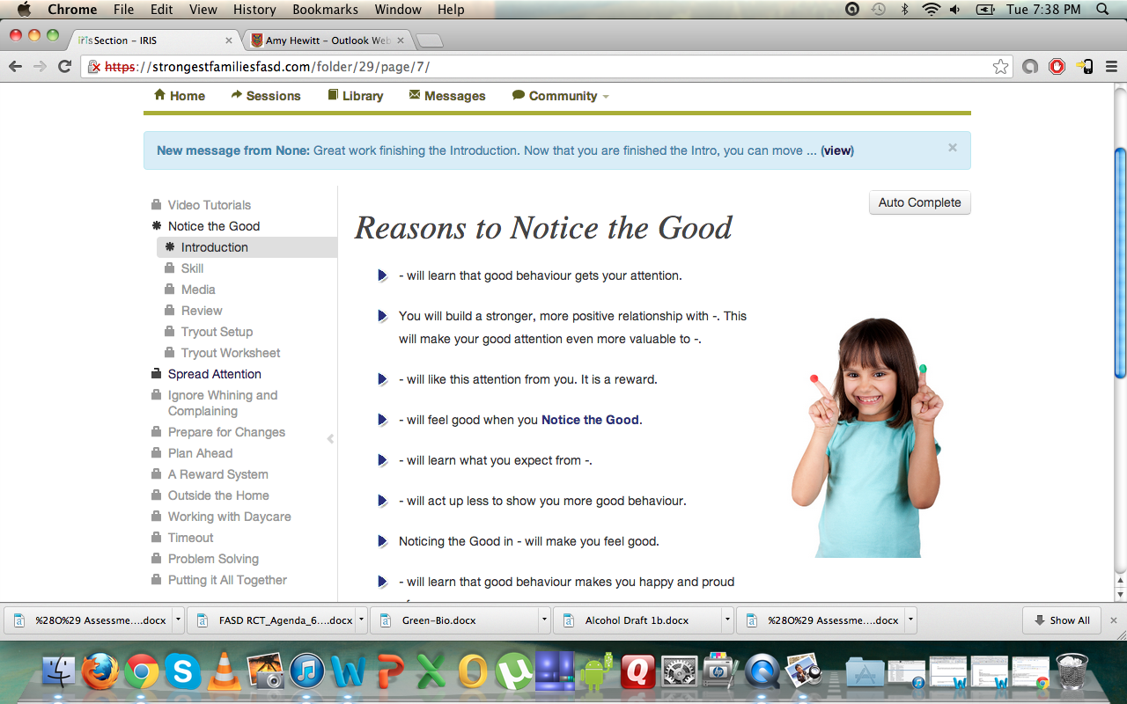
Strongest Families™: FASD
Notes:
Program includes:
Audio and video clips
Worksheets
Coaching
Ask the Expert
Discussion Board

Slide 38
Outline
Project Overview
Data from Stakeholder Interviews
Modules for IRIS
Usability Study
RCT

Slide 39
Usability Study
Recruited 5 caregivers and 5 clinicians
Completed Sessions 1-4 of Strongest Families: FASD Program
Questions Included:
It is easy to use.
It is easy to navigate.
The site is user friendly.
The terms are clear and easy to understand.
The video and audio exercises helped me learn and understand the skills.

Slide 40
Usability Study: Round 1 Results
Videos and audio in general received good reviews.
All 10 participants liked having them in the sessions.
2 clinicians said the website would be too difficult for many of their clients to handle on their own – that the coaching phone calls would not be enough support.

Slide 41
Usability Study: Round 1 Results
2 caregivers said the examples are too long for children with FASD.
2 caregivers and 2 clinicians were concerned with physical contact (hugging, kissing, touching) associated with “ways to notice the good” – concerned that some children with FASD do not respond or like contact.

Slide 42
Usability Study: Round 2
Made some modifications to website
Interviews start Nov 1
Scheduled 8 interviews (4 caregivers & 4 clinicians)

Slide 43
Outline
Project Overview
Data from Stakeholder Interviews
Modules for IRIS
Usability Study
RCT

Slide 44
RCT
Research Question
Does an FASD-specific online caregiver training intervention decrease challenging behaviours in children with FASD and caregiver distress?
Hypothesis
We hypothesize that an online FASD-specific caregiver training intervention will mitigate challenging behaviours in children with FASD and caregiver distress.
Notes:
Research Question
In families caring for children with FASD, does FASD-specific online caregiver training intervention, compared with static online FASD information, decrease challenging behaviours in children with FASD and caregiver distress?
Hypothesis
We hypothesize that an online FASD-specific caregiver training intervention will provide evidence for efficacy in the areas of challenging behaviours in children with FASD and caregiver distress when compared to no caregiver training.

Slide 45
RCT
~ 200 Families
Child age 4-12 yrs with an FASD diagnosis
~20 week commitment
Pre- and Post-Intervention Assessments
100 Families 100 Families
Strongest Families: FASD Static online resource page
CBCL DASS Coaching CBCL DASS

Slide 46
RCT Recruitment
If interested in participating in the Strongest Families FASD Study, please contact:
Amy Hewitt – fasdstdy@queensu.ca

Slide 47
Thank you!
Questions?

