Slide 1

Diabetes
Lisa McGrath and Cheryl Lenover
Halton Diabetes Program

Slide 2
Today, we will talk about…
What is diabetes?
What to do if you have diabetes

Slide 3
Today, we will talk about…
What is diabetes?

Slide 4
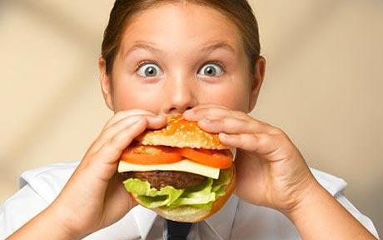
When we eat…

Slide 5

most of our food turns into sugar.

Slide 7



Slide 8
Insulin
Insulin
Insulin
Insulin
Insulin
Insulin

Slide 10
Insulin
Insulin
Insulin
Insulin
Insulin
Insulin

Slide 11
Insulin
Insulin
Insulin
Insulin
Insulin
Insulin

Slide 12
When you have diabetes…

Slide 13
Insulin
Insulin
Insulin

Slide 14
Problems Caused by High Blood Sugars
Brain
Eyes
Kidneys
Heart
Nerves
Feet

Slide 15
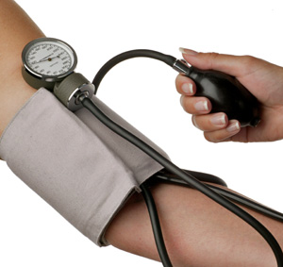
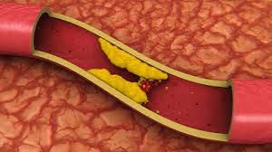
Further damage can be caused by
High blood pressure
High blood fats

Slide 16
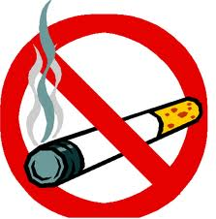
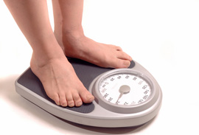
Smoking
Being overweight

Slide 17
Today, we will talk about…
What is diabetes?
What to do if you have diabetes
  Eat well

Slide 18
We get fuel… from food and beverages
Protein
Fat
Carbohydrate
Fuel (Calories)
Notes:
-to help answer this, let’s consider the part of foods that really affects whether we gain weight or lose weight…it is the fuel in our foods and beverages…which is measured as “calories”. This slide shows that calories come from carbohydrate, as you probably know…grains, starches, breads, cereals, baked goods, fruit, and sugars. And calories also come from fat, found in cooking oils, butter, margarine, salad dressing, fried foods, meats, poultry, cheese, eggs, desserts. But, calories also come from protein in foods, again from meats, poultry, dairy products and often overlooked are the calories that come from the alcohol in beer, wine and liquor. So, if you make adjustments to how much of any of these foods, you weight can change.
-we get our fuel calories from all foods, whether they are carb, pro or fat sources…and most foods are a combination of these…e.g. homo milk has calories from all three. Also, keep in mind that the alcohol in wine, beer and liquor is also a source of calories
-So, any weight loss diet plan that reduces any of these calorie sources can lead to weight loss
18

Slide 19
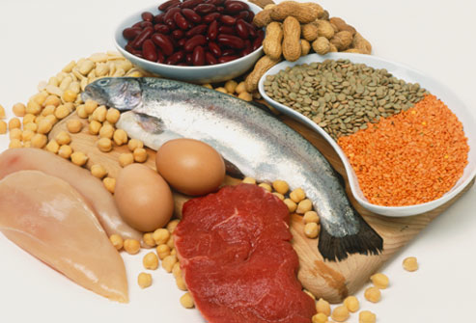
Protein

Slide 20
Protein
Important to build our muscles
Eating too much protein causes us to gain weight

Slide 21


Slide 22
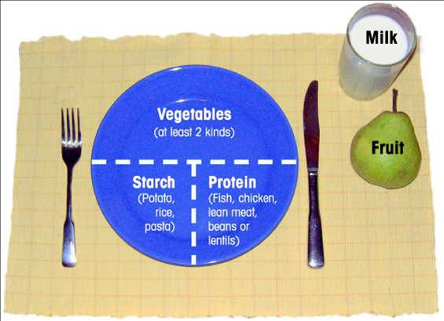

Slide 23
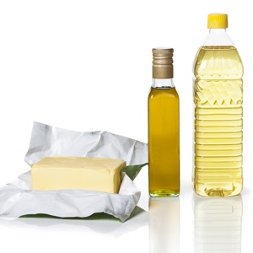
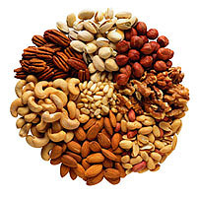
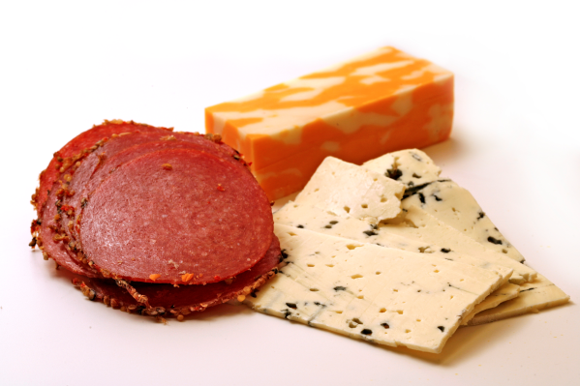
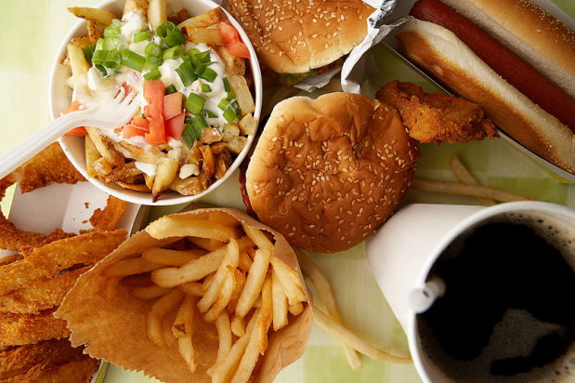
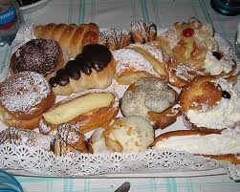
Fat

Slide 24
Fat
Helps with important functions in our body
Eating too much fat causes us to gain weight and raises our blood cholesterol

Slide 25
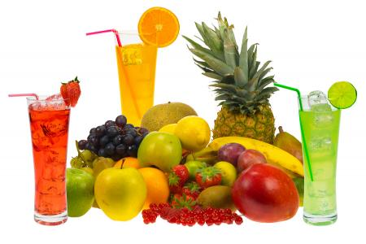
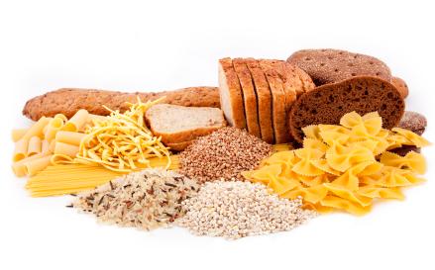
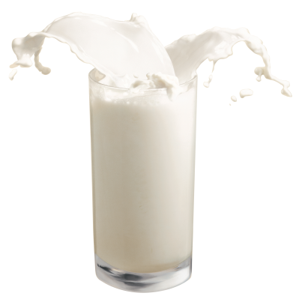

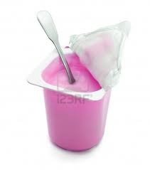
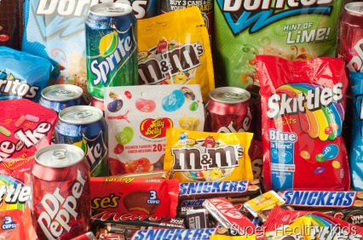
Carbohydrates = Sugar

Slide 26
Carbohydrates
Provide good fuel for our body
Eating too much carbohydrate causes us to gain weight
They raise our blood sugar if we have diabetes

Slide 27

Grains and Starches
Rice, pasta, cereal, bread, potatoes, corn

Slide 29
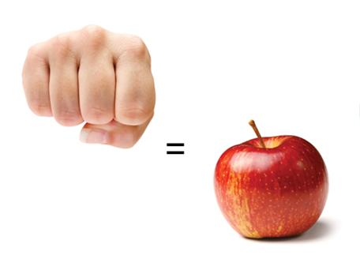
Fruit and Fruit Juices

Slide 31
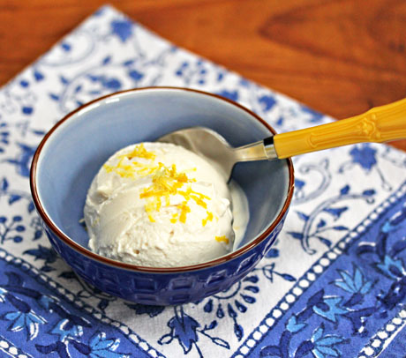
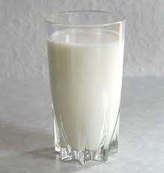
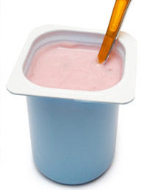
Milk and Milk products
Milk, ice cream and yogurt

Slide 33
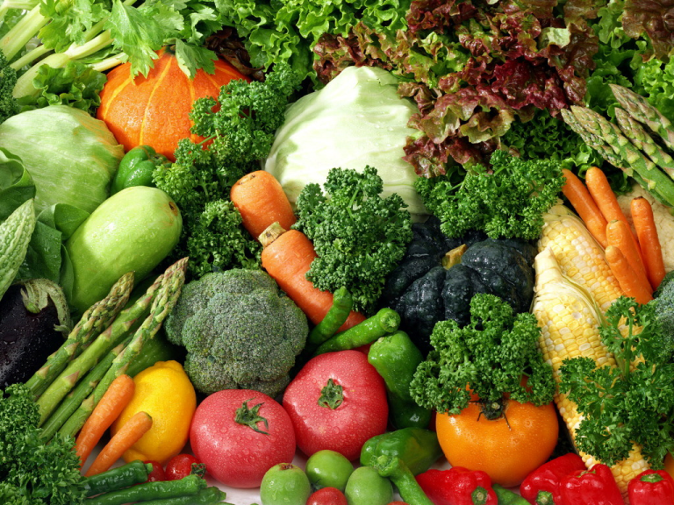
Vegetables
Add vegetables to your plate

Slide 35
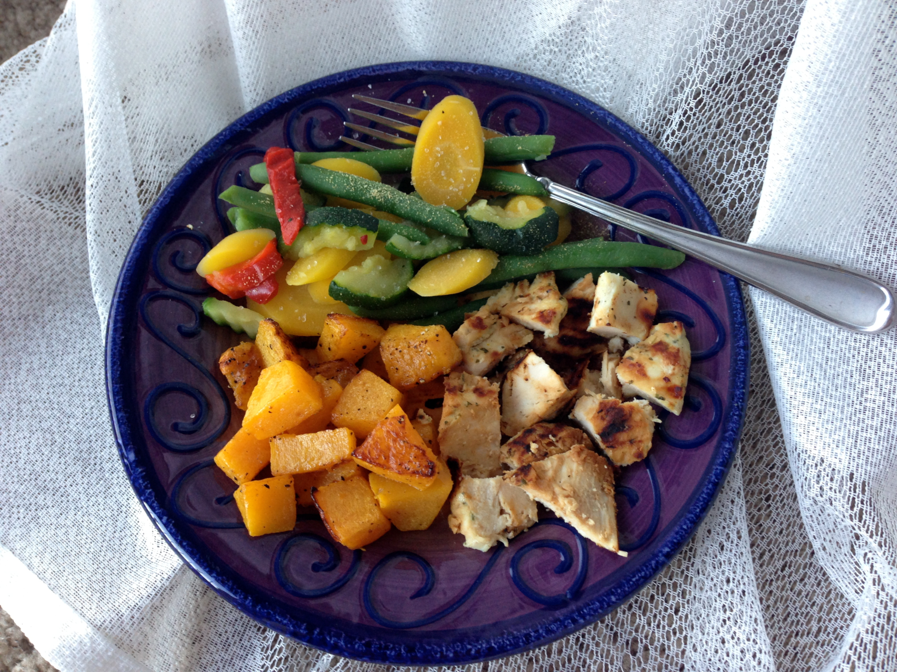

Slide 36
Sugary foods
Pop, candy, chocolate bars, cookies, cakes
Limiting the amount of these foods helps your blood sugar
Select diet pop over regular pop

Slide 37
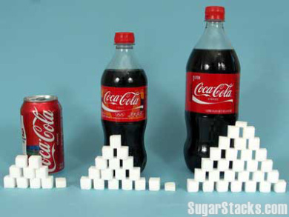

Slide 38
Think about what we eat

Slide 39
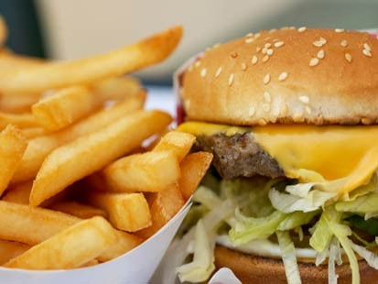
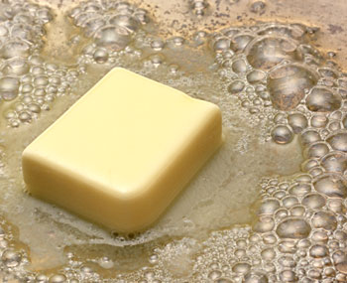
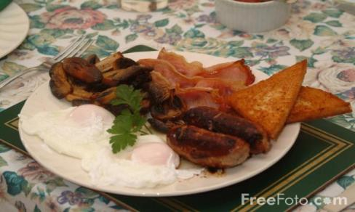
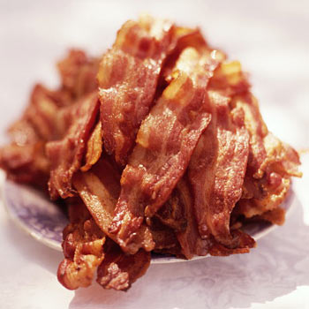
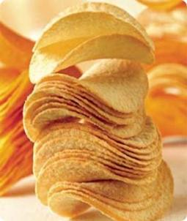
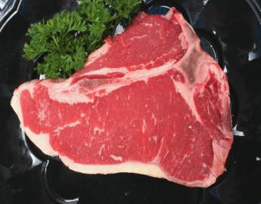
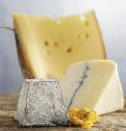
Less fatty food
Notes:
First of all…think about the sources of fat you eat. In the DPP, the participants focused on reducing overall fat intake, as a way of reducing calories…9 calories per gram. For every tbsp of butter, marg or oil, you save 100 calories…over the course of a year, this can help a person lose up to 10 lb! I’ve shown foods with mainly saturated fat and trans fat, because targeting this kind of fat, also can reduce you so-called “bad” cholesterol, and help reduced heart disease risk
39

Slide 40
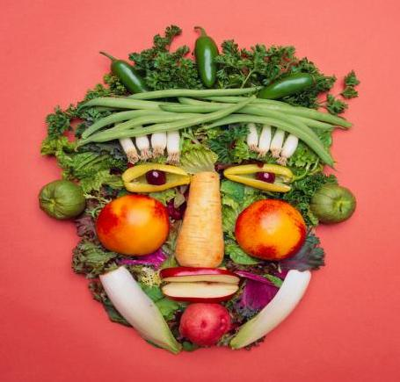
More fruit and vegetables
Notes:
40

Slide 41
Think about when we eat

Slide 42
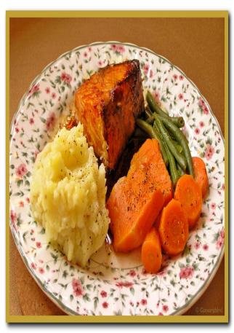
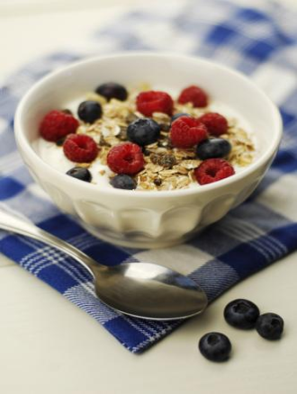
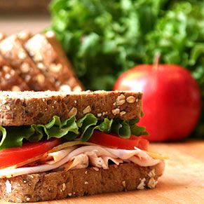
Eating Patterns
Notes:
42

Slide 43
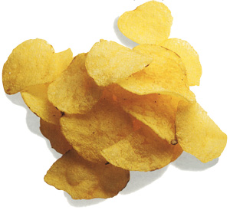
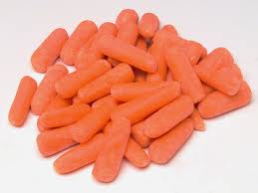
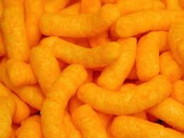
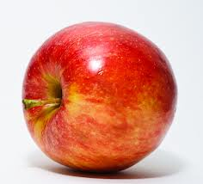
Snacking, is it ok?
Vs.

Slide 44
Think about how much we eat

Slide 45
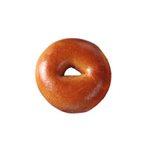
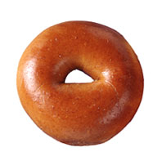
Portion Distortion
20 years ago
Today
Bagel
3-inch
140 calories
6-inch
350 calories
Notes:
Have you heard of “Portion Distortion”? It’s a term describing how typical food portions have crept up in size over the years….we have been getting more calories without realizing.
For example, a bagel from the 1980’s…. Was 140 cal….the typical one nowdays is over 300.
45

Slide 46
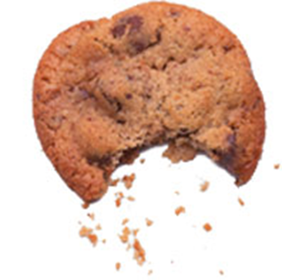
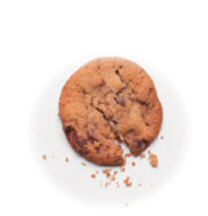
Portion Distortion
20 years ago
Today
Chocolate
Chip Cookie
1 ½ cups
390 calories
3 cups
790 calories
Notes:
46

Slide 47


Portion Distortion
20 years ago
Today
Popcorn
5 cups
270 calories
11 cups
630 calories
Notes:
And movie popcorn
47

Slide 48
Today, we will talk about…
What is diabetes?
What to do if you have diabetes
  Eat well
  Exercise

Slide 49
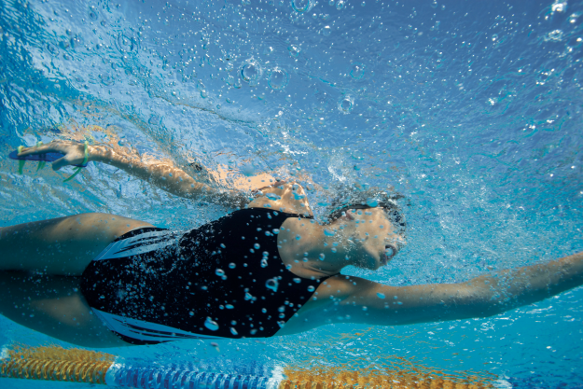
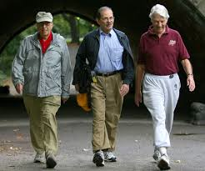

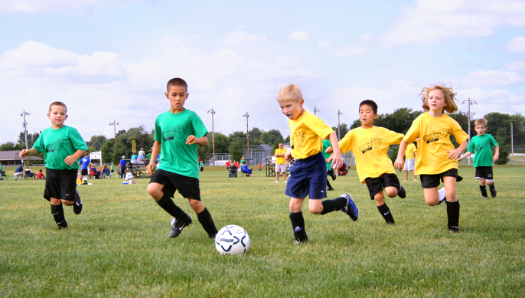
Exercise

Slide 50
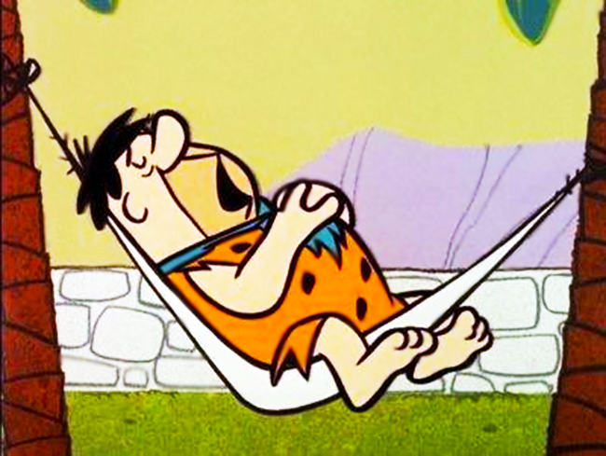

Slide 51
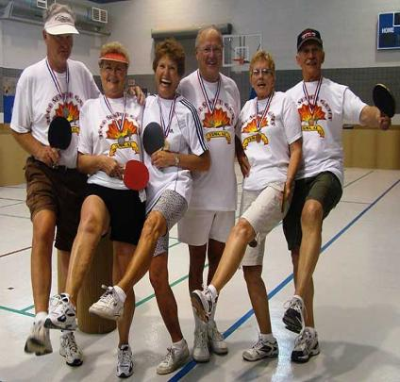
Why get more active?
Why be more active?
Builds your muscles
Keeps your weight down
Lowers blood sugars
Helps blood pressure
Notes:
51

Slide 52
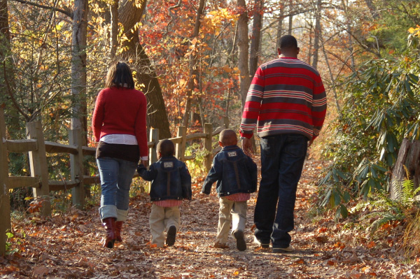
How much is enough?
Aim for 150 minutes per week
Try to be active every day.
Notes:
52

Slide 53
Today, we will talk about…
What is diabetes?
What to do if you have diabetes
  Eat well
  Exercise
  Take your medications

Slide 54
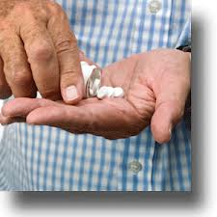



Take your medications, as prescribed by your doctor

Slide 55
Today, we will talk about…
What is diabetes?
What to do if you have diabetes
  Eat well
  Exercise
  Take your medications
  Monitor your blood sugar

Slide 56



Monitoring your blood sugar level

Slide 57


Blood sugar targets
First thing in the morning
or
before meals
4-7
5-10
2 hours after
meals

Slide 58

Some medications and insulin can cause a low blood sugar

Slide 59




Summing it up…

