Slide 1

Health Matters A N.E.W. Lifestyle
Randy Prue, Registered Dietitian
Carole Leveille, Health Care Facilitator
Erin Thompson, Physiotherapist
Wednesday September 19, 2012
N = nutrition
E = exercise Lifestyle
W = wellness

Slide 2
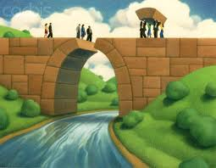
ROLE OF THE HEALTH CARE FACILITATOR
Identify gaps, deficits, and challenges that will require augmentation
Identify specialized training needs and recommend training resources

Slide 3

WHAT IS THE PURPOSE?
To compliment the efforts made by the Ministry of Health and Long Term Care
To build capacity in the local health care community
Expand access to health care for individuals with a dual diagnosis
Notes:
And also a need for assistance with systems navigation.

Slide 4
Live Life Large with Balance
Nutrition & Hydration
Enjoy variety in eating, drinking & exercise
Practise moderation
Healthy Eating is what we do over a lifetime
It’s never too late to make a change.

Slide 5
Presentation is everything! Benefits of Healthy Eating
Increased Vitality
Increased Self-esteem
Increased Independence
Increased Mobility
Increased Resistance to common ailments
- colds, flu
Increased Circulation & Tissue Repair
Decreased Medical Risks
– diabetes, hypertension, osteoporosis, GI concerns, cancer

Slide 6
Healthy Eating Nutrition/Hydration- Barriers
Knowledge
Ability to apply knowledge
Consistency of knowledge application
Communication skills
Mobility
Dexterity
Access to tools and resources
Ability to manage cost
Choice, Respect, Support

Slide 7
Learning Activities A Sampling
Canada’s Food Guide
Rainbow – glow, go, grow
Lunch Box Analysis
Picture Quiz Sheets
In-classroom Grocery Shopping
Food Bingo
Finding ‘Waldo’

Slide 8
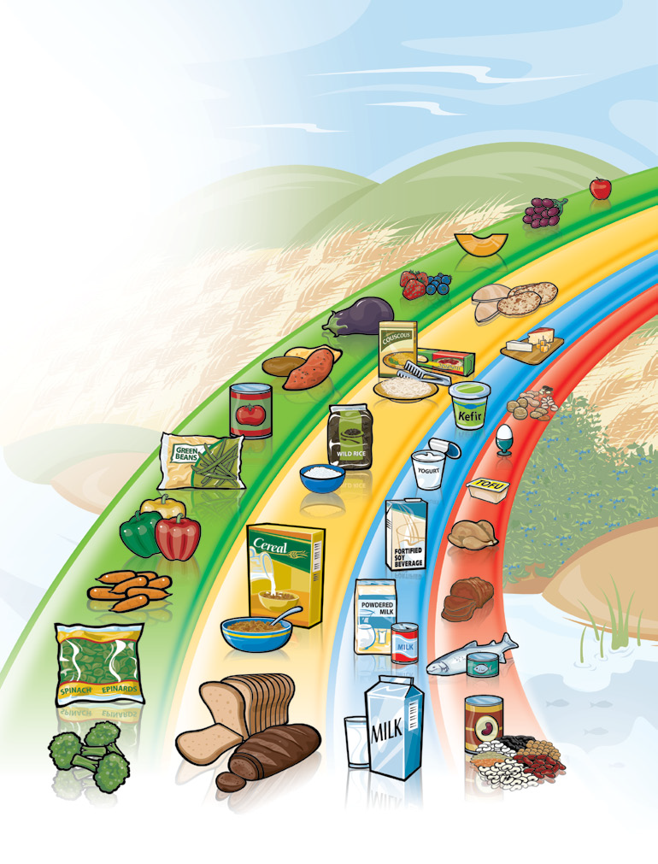
Canada’s Food Rainbow
Eating
Well with
Canada’s Food Guide
General Concepts
Choose 3 of 4 food groups at each meal
Choose a variety of foods daily
Manage the ‘extras’ added to the meal
Manage the portion size
Read food labels
Be Active
Canada

Slide 9
Canada’s Food Guide
Rainbow
Inside Parts:
Food Servings per day
What is a food serving
Tips for best food selection
‘Other’ foods – Oils & Fats
Empty Calorie foods
Fluids for Hydration
Be Active

Slide 10




1 tennis ball = 1 serving of fruit
The Magic of Body Parts managing portion sizes
A fist or cupped hand = 1 cup
A thumb = 1 ounce of cheese
Palm = 3 ounces of meat

Slide 11

RATE YOUR PLATE Compare Today's Food and Fluid Intake With Canada's Food Guide
Record Today's Servings Date:
 | Vegetables & Fruits | Grains Products | Milk & Alternatives | Meat & Alternatives | Other Foods | FLUID (8oz. portion)
Breakfast
AM
Lunch
PM
Supper
Evening
My SCORE
TOTAL Recommended For Me
MY NEXT ACTION:________________________________________________________

Slide 12
Lunch Box Analysis Rate your Plate
Lunch + AM/PM Snacks
Calorie Equivalents
Vegetables + Fruits
= 2 servings
Grain Products
= 2 servings
Milk + Alternatives
= 1/2 Serving
Meat + Alternatives
= 1 Serving
Vegetables + Fruits
= 200 Calories
Grain Products
= 200 Calories
Milk + Alternatives
= 65 Calories
Meat + Alternatives
= 200 Calories
Total = 665 Calories

Slide 13
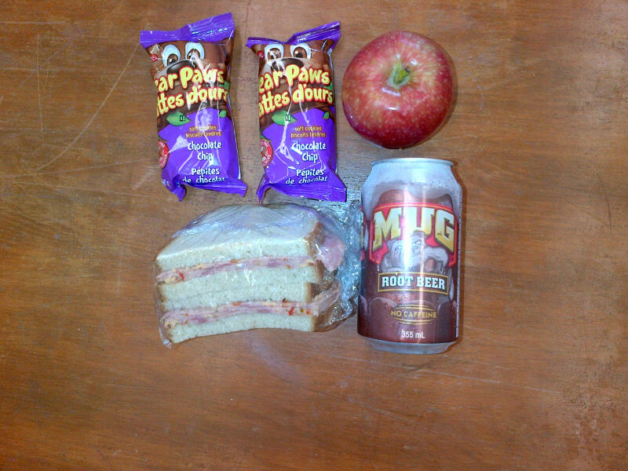
Lunch Box 3

Slide 14
Hydration
All liquids are not created equal
Liquids take the shape of the vessel
Listen to body communication

Slide 15
Strategies for Success
Lead by example
Engage clients in developing tools about food
Apply Healthy Eating & wise food choices daily
Encourage fluid intake (hydration) often
Talk about media releases – current info in news
Be consistent Always - Everyday, Everyway
Repetition, Repetition, Repetition
Fun

Slide 16
Keep Moving (Exercise)
FACT:
Exercise actually decreases the appetite
The body requires rest following exercise in order to utilize the nutrients that have already been consumed.
FACT:
Exercise rewards the body with a ‘feeling good’ sensation = vitality (more energy)
Fluids are needed post exercise - No ‘extra’ food is needed following exercise. Any food taken should be part of the allotted daily food intake.

Slide 17
All Foods Can Fit
…Make your choices work for you.
If weight is a concern
→ cut down NOT out.

Slide 18
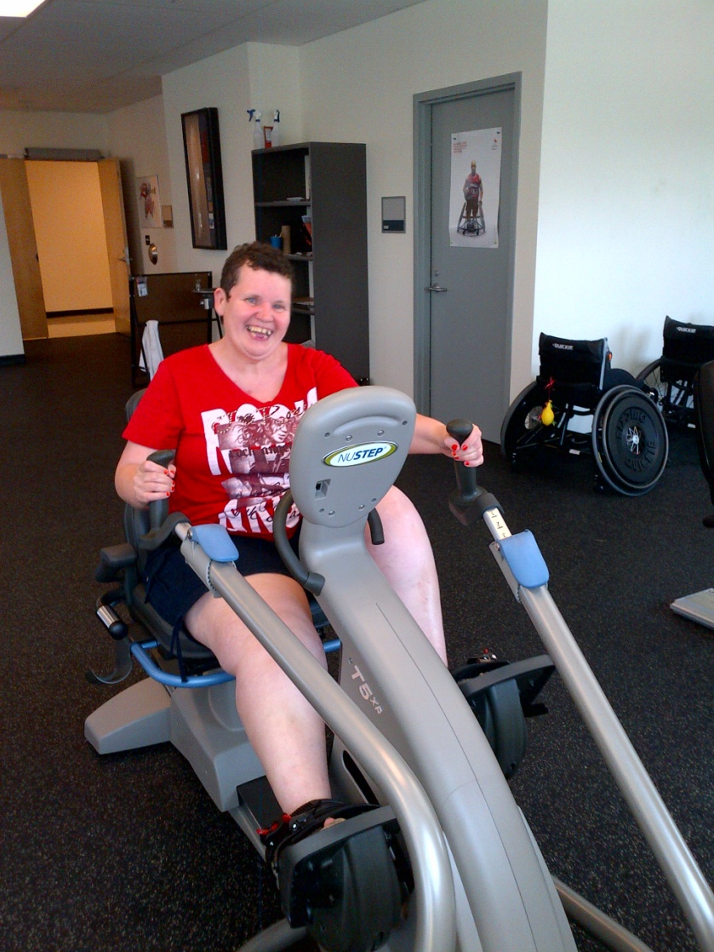
Exercise Considerations in Developmental Disabilities

Slide 19
Benefits of Exercise
Maintaining a healthy weight
Maintaining good cardiovascular health
Improving energy
Creating positive self-image
Providing opportunities for social interaction
Improving sleep patterns
Improving digestion and metabolism
Improving mood and behaviour
Providing routine and structure
Providing novel environments and stimulation

Slide 20
Barriers to Exercise
Individual
Systematic
Complex medical conditions & restrictions
Limited physical ability
Limited understanding
Limited attention
Inter-personal and behavioural challenges
Environmental / access barriers
Inappropriate exercise equipment
Limited assistance available
Time
Cost
Note: although certain challenges may prohibit some types of exercise, remember that everyone can participate in exercise in some way!

Slide 21
Precautions and Considerations
Do a risk assessment of planned activity
When in doubt, obtain informed consent and medical history
Consider potential precautions to exercise (common conditions include: congenital heart abnormalities, seizure disorders, joint laxity, impaired sensation, balance & motor planning impairments)

Slide 22
Precautions and Considerations
Consider safety of environment/equipment and appropriate assistance levels.
Make program fit within routines and schedules.
Provide extra time for preparations and explanations of activity. (Repetition of skills is often helpful.)
Balance age-appropriateness with FUN!

Slide 23
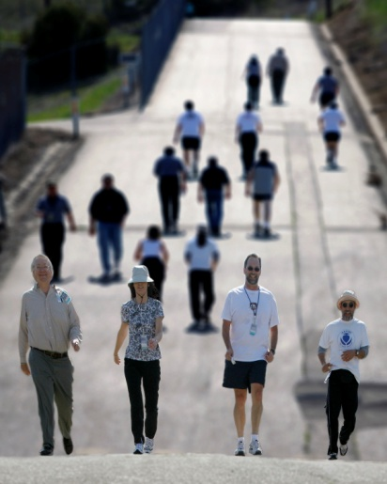
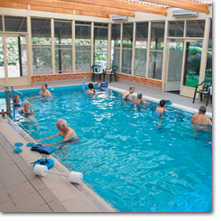
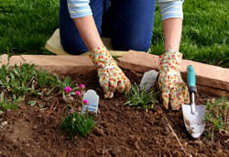
Exercise Opportunities
Walking groups
Swimming, aquafit & hydrotherapy
Dance and fitness classes
Fitness videos
Low-intensity resistance training
Sports
Games of low organization
“Heavy” work

Slide 24
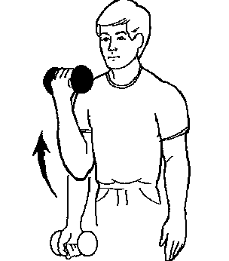
Fitness Parameter Guidelines
Resistance:
weights at amount able to be lifted with moderate effort 8-12 times
movement in middle ¾ of total joint range
watch for poor alignment, shaking limbs, etc.

Slide 25
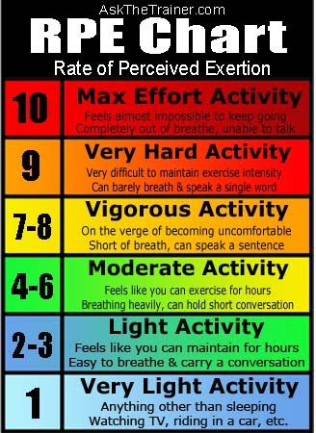
Fitness Parameter Guidelines
Cardiovascular:
220 – your age = HRmax
Exercise heart-rate should be within 50-80% of this
Often best to use a Rating of Perceived Exertion (RPE)

Slide 26
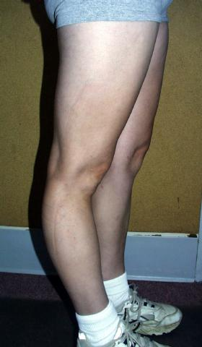
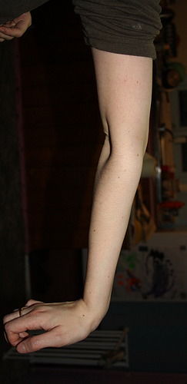
Fitness Parameter Guidelines
Stretching/Flexibility:
Should be done after some cardio activity
Do not force
Do not bounce
Do not stretch beyond normal range of motion
*be mindful of musculoskeletal conditions (joint laxity) and neuromuscular conditions (spasticity)

Slide 27
Program Partnerships
Schools, local instructors, teams, clubs, etc.
Example: “Revved Up” with Queen’s University
Organized by the Kinesiology Program
Groups of 8-10 participants
Each 1-to-1 with a student “exercise buddy”
2 sessions per week for 8 weeks
1-hr circuit work-out with basic cardio and weight-training sets.

Slide 28
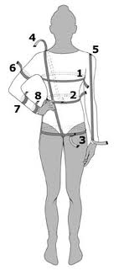
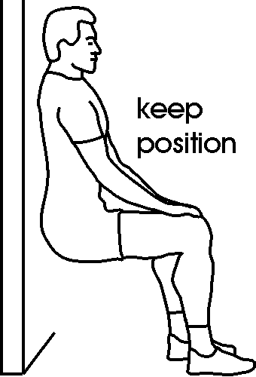
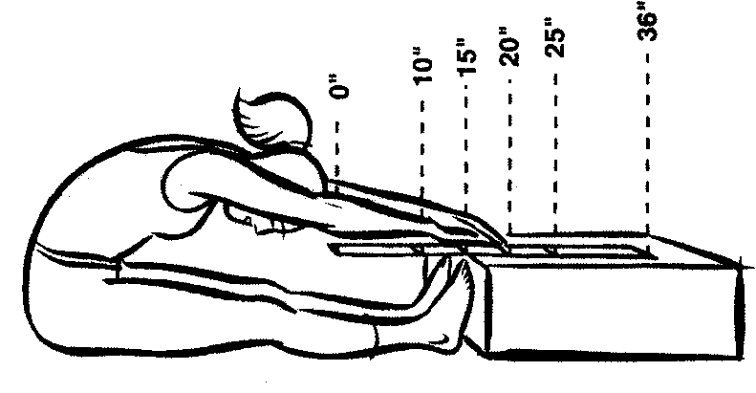
Outcomes
Objective
Weight loss (lbs./kg)
Girth/Circumferences (in./cm)
Cardiovascular Endurance (6-min Walk Test)
Muscular Endurance (Sit-to-stand, Wall-sit)
Strength (lbs./kg lifted)
Balance (Forward reach test)
Flexibility (ROM, Sit & reach test)

Slide 29



Outcomes
(Not-so) Objective (but still nice to show...)
Testimonials:
Attitudes - Self-image
Socializing - Sleep
Digestion - Function
Skill development
Participation level (how much time, distance walked, etc.)

Slide 30
Resources – Fun & Facts
www.dietitians.ca/eatracker
Dietitians of Canada
www.canadian-health-network.ca
Canadian Health Network
www.eatright.org
American Dietetic Association
www.mypyramid.gov
USDA food guidelines

Slide 31
Resources
www.phac-aspc.gc.ca Canada’s Physical Activity Guide (tip sheets, toolkits, posters, etc.)
www.csep.ca Canadian Society for Exercise Physiology (guidelines and standards, tip sheets)
Health Matters: The Exercise & Nutrition Health Education Curriculum for People with Developmental Disabilities (B. Marks, J. Sisitak, T. Heller – Paul H. Brookes Publishing Co.)
Therapeutic Exercise in Developmental Disibilities (B. Connolly, P. Montgomery – Slack Inc. Publishing)

Slide 32

For more information 613.548.4417 ext. 3305 cleveille@ongwanada.com

