Slide 1

Strategies for Successful Doctor's Appointments:
How health care professionals, parents and caregivers can collaborate to support individuals with
Intellectual and Developmental Disabilities
Networks of Specialized Care Videoconference Series
February 20, 2015
Dr. Liz Grier, MD, CCFP
Community Physician, Kingston
Special Interest Practice in Care of Adults with Developmental Disabilities

Slide 2
Faculty/Presenter Disclosure
Faculty: Elizabeth Grier
Relationships with commercial interests: None
This program has not received financial support or in kind support from any commercial organization
Potential for conflict(s) of interest: None
Notes:
This slide must be visually presented to the audience AND verbalized by the speaker.

Slide 3

Objectives for today:
Background
How can doctors offices help?
How can parents and caregivers help?
Tools to support communication and care
Discussion

Slide 4

Doctors appointments can be very stressful for patients, caregivers and health care providers
Yet, individuals with intellectual and developmental disabilities (I/DD) have greater number of health problems and so barriers to accessing care must be addressed
Solutions are not just logistical (i.e. time, space, accommodations)
As important are positive attitudes, good communication and building relationships
….So let’s look at how we can all help from our different perspectives!

Slide 5
Developmental Disabilities Primary Care Initiative
Funded by the Ministries of Health and Community and Social Services
Led by Dr. Bill Sullivan and based out of Surrey Place Centre
Developed the primary care guidelines for care of adults with I/DD
Also a number of clinical tools – both for caregivers and for health professionals
Website: http://www.surreyplace.on.ca/primary-care
We will focus on three tools today: Office organizational tips, Caregiver’s Health Assessment Tool, Today’s visit

Slide 6
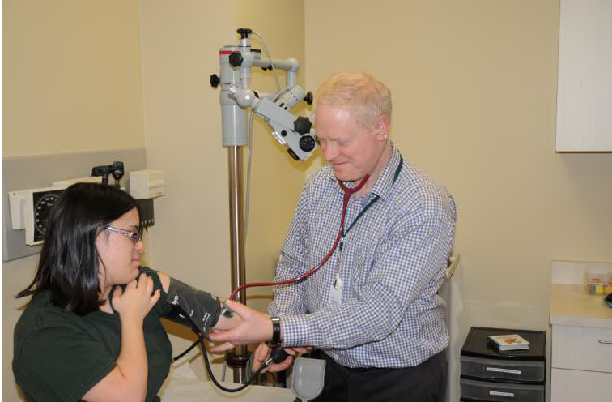

Slide 7
What can the physician or health professional do to ensure appointments go well?
Answer:
Use the office organization tips tool

Slide 8
Primary Care Provider Preparations:
• While the focus of relationship building and communication should be on the patient with DD, it is also important to establish a relationship with, and obtain information from, the patient’s main caregivers (e.g., family, group home staff and manager).
• Consider inviting caregivers who know the patient well to come for a pre-appointment visit. Provide them with the Caregiver’s Health Assessment tool prior to the first visit so that they can complete as much as possible prior to the appointment.
• Try to alleviate the anxiety of the patient with DD by asking caregivers to bring to the appointment a familiar and comforting object from home (e.g., music, book).
• Explain to caregivers the importance of ensuring that the person who accompanies the patient with DD is reliable and familiar with the patient’s current health issues.

Slide 9
Collaborating with Developmental Service Agency Supports
Emphasize the importance of seeing the lead caregiver with the agency:
“Dear (DS Agency – Case manager),
It is a pleasure to welcome John Doe to my family practice. Our practice endeavours to provide comprehensive, appropriate care for individuals with developmental disabilities including annual health checks and regular medication reviews.
I am committed to collaborating and communicating clearly around health issues and care instructions for staff and appreciate your engagement in this regard.
I ask that when I see John in clinic, that he be accompanied by his lead developmental service worker who is most familiar with his past medical history and any current concerns and presenting symptoms.
I look forward to working with you as a team to provide the best quality of care for this patient.
Sincerely,”

Slide 10
General Office Preparations
• Meet with office staff to discuss office organization and accommodations for visits by specific patients with DD.
• Assess the physical access to the office and equipment required prior to the appointment.
• Check accommodations that may need to be made (e.g., for some patients with autism, taking off one’s glasses may be important, or for patients with pica, removing objects from the waiting and examining rooms that could be eaten).

Slide 11
General Office Preparations cont
For patients with DD who are quite anxious about visits to the doctor:
– Have patients visit the office at least once and, if possible, two to three times, to acclimatize themselves to the office and for an introductory ‘meet and greet’ session.
Such initial visits should only involve meeting staff and getting used to sounds and smells (i.e., no examinations or treatments).
– Encourage caregivers to drop in with patients with DD to allow them to become familiar with the environment.

Slide 12
General Office Preparations con’t
• Reduce stress by respecting the patient with DD’s limits (i.e., it may take several visits to complete a physical exam).
• Take a proactive approach to avoid potential difficulties (e.g., by using rewards or distractions).

Slide 13

“First check up…then Blanche pictures”

Slide 14
Initial Appointment:
Allow sufficient time to assess the patient with DD’s communication skills and to establish rapport (may need to book a double appointment).
• Be prepared to end an appointment early if it becomes distressing to the patient with DD.
• For patients with autism, book a time for the appointment that least disrupts their daily routines.
• Inform your office staff when a new patient with DD will be arriving. Schedule the visit time to minimize the waiting

Slide 15
Instruct staff that they are welcome to take the patient with DD and caregiver(s) directly to an appropriate room away from the noise of the waiting room.
• Greet the patient with DD first. Ask whether you may use their first name and whether the caregiver(s) can stay.
• Inform patients with DD that you may later ask whether you can examine them alone.
• Agree on an agenda at the beginning of the visit with all present.

Slide 16
It may take a few visits to understand adequately a complicated medical history and to establish mutual trust in order to allow uncomfortable or invasive examinations.
• Corroborate the history with different caregivers involved in the life of the patient (e.g., group home and day program workers), either during office visits and/or through later telephone conference calls.

Slide 17
Physical Examination:
Specific advanced preparation and coaching may be necessary for intrusive examinations (e.g., pelvic examinations in women). (See resources available at the Surrey Place centre website or at the Centre for Developmental Disabilities Health in Victoria, Australia - http://www.cddh.monash.org/)
• Ask permission to proceed before any intrusion of the patient with DD’s personal space.
• Explain and warn the patient about what to expect from procedures that may need to be done
immediately.
• Ask caregivers whether individual care plan or protocols have been established for some procedures (e.g., venipuncture) and follow these.
• Provide reassurance during the procedure.

Slide 18
For bloodwork, X-rays or physical exams, some patients may require various strategies that may include social stories about this exam, continued reassurance and support, and a desensitization plan.
For patients with DD who are resistant to a physical exam, consider gradual repeated exposure to the office and instruments such as the exam table and blood pressure cuff. Eventually, when patients with DD feel safe enough, invite them to lie down on the examination table.
• Use of topical anaesthetics, such as EMLA cream (apply at least one hour before procedure) or a sedative medication, such as lorazepam, may be helpful prior to distressing procedures, such as blood tests and radiological investigations.

Slide 19
Referrals and Prescriptions:
When referring, identify that this is a patient with DD. Send as much information as possible, including any adaptations, accommodations or communications that you have found helpful with this patient (i.e., all the information you would like at a first visit).
• Consider a direct telephone call with the specialists concerned so that they understand the referral question and the complexities that may be faced in evaluating particular patients with DD.
• Send a copy of any new prescription to the patient with DD’s pharmacist, maintain a copy on the chart, and provide the patient or caregiver with a copy.

Slide 20
How can health care professionals help?
Conclusions:
Approach the patient and their caregivers with respect
Listen well and use effective communication strategies
Prepare, prepare, prepare
Be patient and willing to adapt processes creatively
- Keep clear records and communicate collaboratively with specialists, pharmacists, developmental service agencies and families

Slide 21
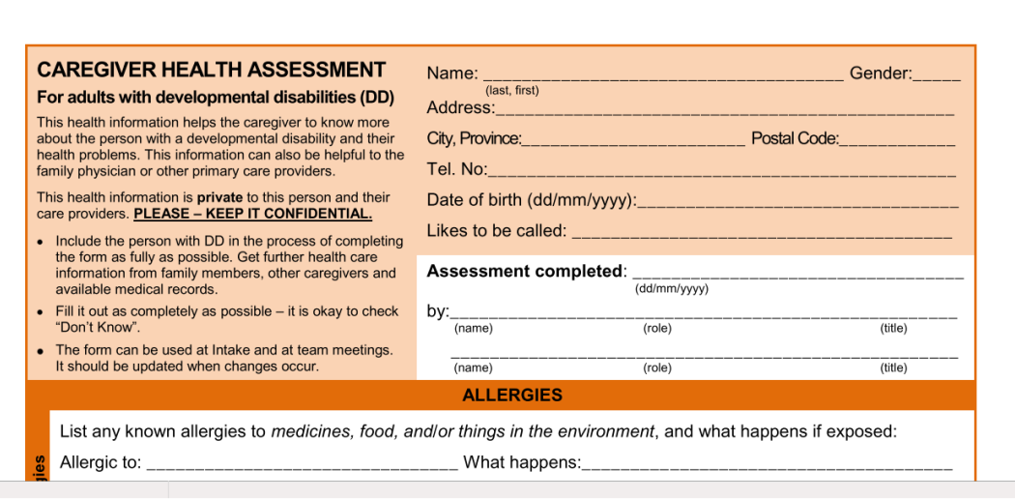
How can parents and caregivers help?
Caregiver Health Assessment Tool – a long form that benefits from updating every 1-2 years – may be coming out with some revisions
Today’s Visit Tool

Slide 22
Baseline history about the developmental disability that is important to know
Level of Intellectual Disability: (mild, moderate, severe, profound – comments on adaptive living skills also helpful)
Psychoeducational Assessment: (date)
Etiology (cause) of Intellectual Disability: (genetic syndrome, traumatic, hypoxic, brain malformation)
Genetic Assessment: (Date)
Previous Neuroimaging: (MRI, CT but also include EEG here)

Slide 23
‘Social history’ that is important to know:
Living Arrangement: (who does the person live with?)
Decision Making Capacity: (independent? If so, for what decisions?)
Substitute Decision Maker: (if applicable) Phone:
School:
Resource Teacher: Lead EA:
Developmental Service Agency:
Case Manager: Phone:
Additional Services:

Slide 24
Supports and Services con’t:
Social Support Programs: Ontario Disability Support Pension in place if eligible? Yes___ No ____
Special Services At Home if eligible? Yes____ No ____ Disability Tax Credit if eligible? Yes____ No____
Current Vocational and Recreational Programs, Day Program, Respite Services:
 | Agency Name | Program Name | # visits/days per week/month
1
2
3
4

Slide 25
Issues that are important for accessing health care:
Communication: verbal, sign, PECS, is there a communication book?, ipad?
Sensory Integration: fluorescent lighting, noise, difficulty with touch
Response to Pain/Distress: localizes pain, can verbalize? Becomes aggressive or irritable?
Mobility: wheelchair, cane, walker, how do they transfer to the exam table
Safety Concerns: pica, flight – anything the medical staff need to know about
How does the patient respond to physical examination?

Slide 26

Aides for appointments: picture schedule, ‘first-then’, important rewards or routines
Personal interests to help get to know the individual?
Ex. Loves the Montreal Canadians
Story lines, step by steps – using real photos is great if possible!

Slide 27
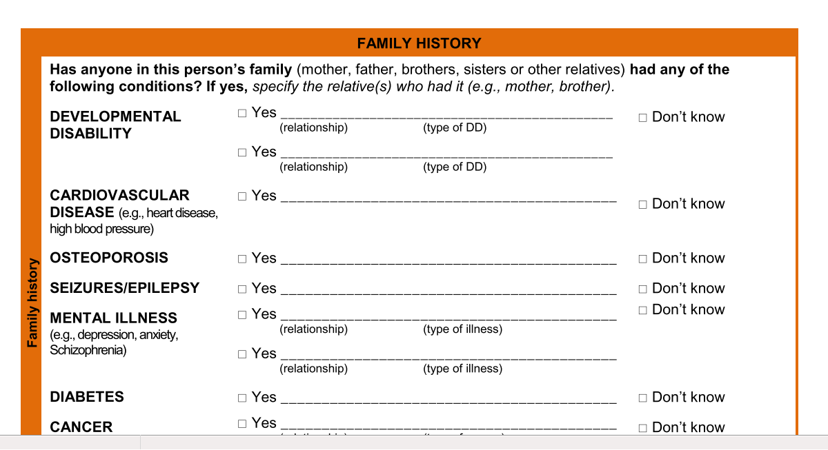
Family History – Very helpful to have the help of caregivers in obtaining

Slide 28
Symptom: | Please describe:
Lethargy/Weakness | - is it new, localized or generalized
Weight (under/overweight) | - is weight changing, is diet a problem
Spasticity/Contractures | affecting function ex. Ability to feed oneself?
Skin Issue | rashes, pressure sores for w/c bound pts
Dental Problems | regular dental possible?
Vision Problem | has vision been checked?
Hearing Problem | has hearing been checked, wax buildup?
Sleep Apnea | -snoring, gasping in the night or stopping breathing, morning headache, sleepiness
Recurrent Pneumonia
Swallowing concern | -coughing, choking with feeding, rumination
Feeding issue | -either with diet or around meal time
Reflux/Heartburn | -hand mouthing, salivation
Constipation/Bowels | -see bm monitoring chart
Urinary Problem | -new incontinence, malodorous
Menstrual Issue | -pain, irregular bleeding and affect on function
Sexuality concern | -self stimulation or intercourse
Behavioural problem (aggression, self injury)
Insomnia | -see sleep monitoring chart
Low mood or anxiety

Slide 29
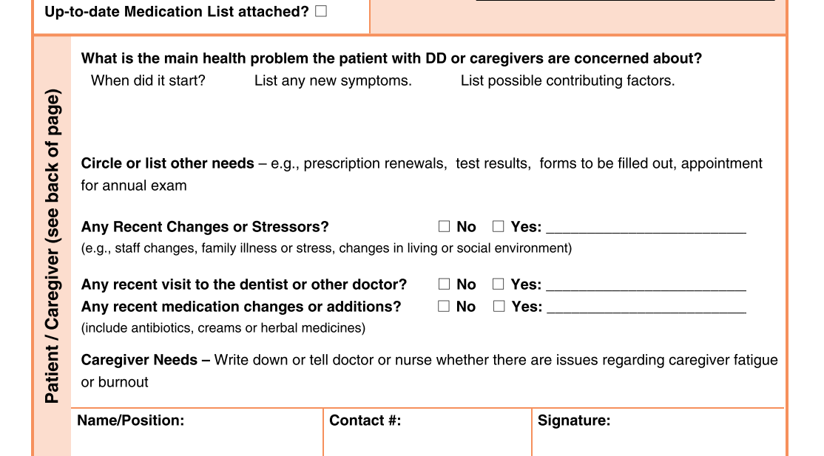
Today’s visit tool

Slide 30
Thinking about the presenting concern – the three tough ones:
functional decline – what skills are lost? Examples are so helpful. When did it start? Does the impairment fluctuate or is it constant? Is it across environments?
failure to thrive or weight loss – thinking about that review of systems is very helpful, how much weight over what time period? Is there a feeding issue – even a subtle one is helpful to know about

Slide 31
3. behavioural issue – timelines and ABCs are important but here are some signs to consider an underlying physical cause:
New behaviour
Recurrence of previously stable behaviour
Exacerbation of behaviour (increased frequency, duration)
Unclear precipitant for behaviour (random)
Association with: eating, touching or moving patient, toileting, night waking, menses
Care giver concern: “He’s just not himself”
Failed response to previous treatments that were effective
Associated symptoms or physical findings (see handout)
Tracking tools – any behavior, bowels, periods, seizures, sleep, weight, pain
See surrey place centre site for some great examples

Slide 32
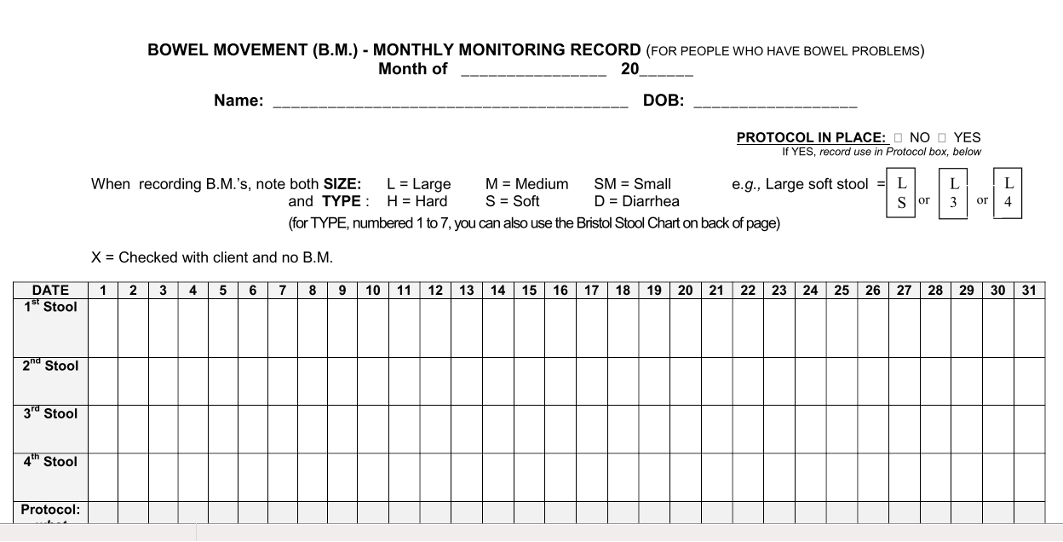

Slide 33
Medications and medication reconciliation:
Please either bring the Medication Administration Record (MAR) or the pill bottles themselves (regular and as needed and vitamin supplements etc.)
PRN charting very important
Best approach is full three way communication through the pharmacist. Physician should advise pharmacist when a medication is being discontinued and any dose changes via prescription.
3 month medication reviews with a new list provided to the caregiver from the pharmacy important
Medication reconciliation after hospitalizations – very important both at the pharmacy and the doctors office

Slide 34
Importance of annual health checks –
An annual health review is an evidence based guideline for all patients with developmental disabilities and generally should include:
-wt and blood pressure
-a directed physical examination
-blood work
-some years may include a bone density, pap smear, mammogram or occult blood or colonoscopy recommendation
- We recommend that physicians fax these to the hospital along with the cumulative patient profile (summary of problems and meds etc)

Slide 35
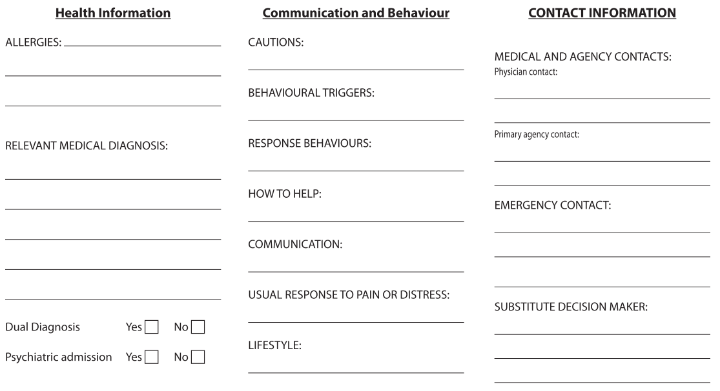
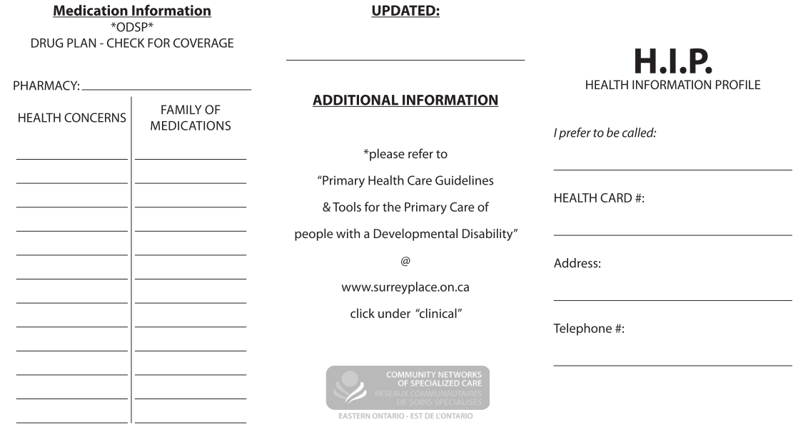
Health information passport
Great to update annually also

Slide 36
19 yr F
Autistic Disorder, Severe, Comorbid Intellectual Disability
Minimal verbal communication (yes/no) and some Picture Exchange Communication use
Past medical history includes episodic severe constipation treated with PEG (polyethylene glycol).
Selective eating is also an issue – she will eat some poached chicken or salmon if cooked a specific way. Her only fluid intake is full strength fruit juice.
Sensory Integration – working closely with OT over many years for this. She experiences great difficulty with florescent light, crowds, loud noises and unpredictable environments. She is very soothed/stimulated by tactile input (touching cloths or beads) and loves music. Family brings headphones and MP3 player when she needs to come to unfamiliar places.

Slide 37
Thank you!
Questions and comments welcome!

