Slide 1
Presented by: Jodie Petkovich Hamilton Brant Behaviour Services Tracey Miles Barrett Centre Crisis Support Christine Squires St. Josephs ACT 11 March 5th 2015
Dual Diagnosis
&
Addictions
Supporting people
With Developmental Disabilities

Slide 2

Prevention Have fun being yourself

Slide 3
Overview
Suggestions for clinicians when supporting people with developmental disabilities.
Prevention/safe drug and alcohol use
Defining Addictions
Identifying when people need help
Stages of addiction
Recovery tool box

Slide 4
Adaptations : Suggestions for Clinicians
Suggested readings/authors
First Stage trauma treatment: A guide for therapists working with women. Dr. Lori Haskell Toronto: CAMH
Trauma Treatment with Clients Who Have Dual Diagnoses: Developmental Disabilities and Mental Illness. Margaret Charlton Ph.D. Brian Tallant, M.S Presented by NCTSN 2003

Slide 5
continued
Healing Trauma; the power of Group treatment for People with Intellectiual Disabilities. Nancy J Razza & Dr. Tomasula. 2005

Slide 6
General Suggestions
Slow down speech.
Use comprehensible language.
Use visuals to support language.
Present information one item at a time.
Ask for feedback after each item is presented.

Slide 7
Cont.
Be specific about steps to change
Practice coping skills and encourage feeling of competence
Be aware of bias when working with this population. (Avrin, Charlton, & Tallant, 2002, Charlton, 2002: Mansell & Sobsey, 2001;Butz, Bowling, & Blitz 2000).

Slide 8
Challenges /vulnerabilities
Employment opportunities for the developmental population may be limited.
May require support to engage in healthy social activities and find acceptance.
Lack of comprehensive and ongoing preventative education.
Current models for maintaining recovery may be geared towards the general population.
May require support to access resources consistently.

Slide 9
Where do we start?
Research/ pilot projects. In the process of developing a pilot prevention and recovery group with support from the Trauma Initiative committee, Southern Network of specialized care.
Ask those with developmental disabilities what will help and what doesn’t help.

Slide 10
cont.
Collaboration with experts in addiction. Adapting current programs so that they are “user friendly”
More similarities then differences when providing service to these two populations?

Slide 11
Prevention : Things to consider
Information and education that is comprehensible, and accessible.
Risks related to alcohol consumption include: age, gender, health, amount of consumption and family history (Canada’s Low Risk Alcohol Drinking Guidelines)

Slide 12
Include education about any dangers of mixing alcohol and drug use.
Do not assume that the person understands and can generalize risk.
Fully explain the link between alcohol use and certain diseases.
Explain the relative immediate effects of too much alchahol.

Slide 13
Be specific about the impact:
You might do things when you are drunk that you would not do otherwise.
Make choices that might get you in trouble. Example spend too much money.
Change your mood, lose your temper.
Don’t leave your drink unattended
Can become vulnerable to be taken advantage of, robbery

Slide 14
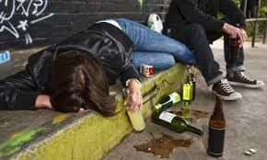

Slide 15
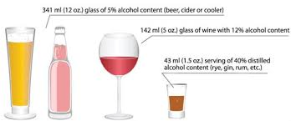

Slide 16
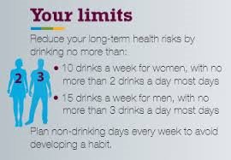

Slide 17
Decide how many drinks you will have before going out.
Decide how you will get home.
Provide options i.e.. May want to consider fancy non alcoholic drink.
Peer pressure. Create possible social situations and support people to practice what to do.

Slide 18
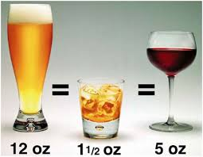
Create reminder key chains

Slide 19
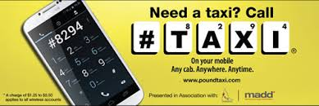

Slide 20
Understanding Addictions
Addiction is a primary, chronic, neurobiological disease, with genetic, psychosocial, and environmental factors… It is characterized by behaviours that include one or more of the following:
Impaired control over use
Compulsive use,
Continued use despite harm, and craving
(Savage et al., 2003).

Slide 21
Addictions Continuum
Experimental Use
Dependence
Social Use
Abuse

Slide 22
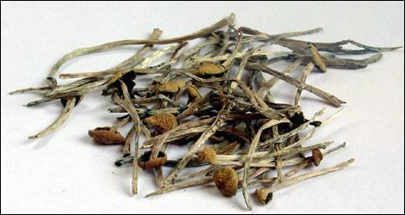
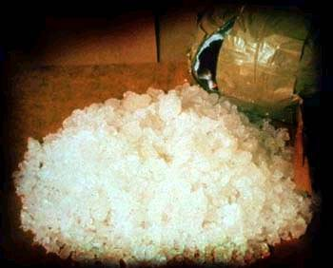
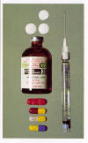
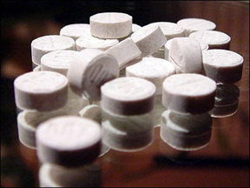
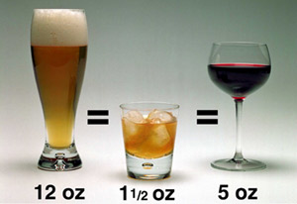
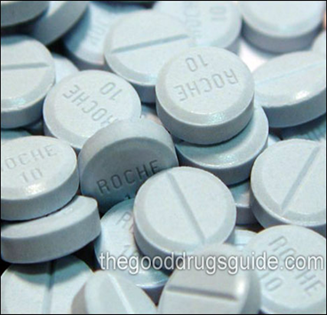

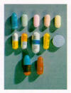

Slide 23
Why do People Experience Addiction Problems?
People often use drugs/alcohol as a means of gaining acceptance and connectedness with a peer group
People interpret being with the party crowd as being associated with the popular crowd
People often use addictive behaviour to help them manage a situation which they feel they are lacking certain skills. In particular, situations such as socializing, managing stress, use of leisure time, taking on new challenges, building relationships, intimacy and communication
People may use addictive behaviour to shut off thoughts or ideas which are overwhelming, confusing or negative
People may turn to addiction to shut off memories (recent or historical) of difficult experiences in their lives

Slide 24
Signs of Substance Abuse
Neglecting responsibilities.
Using alcohol/drugs under dangerous conditions or taking risks while high.
Alcohol or drug use creates legal issues.
Alcohol or drug use causes problems in relationships.
Building tolerance.
Substance is used to avoid or relieve withdrawal symptoms.

Slide 25
continued
Loss of control over the substance
Abandonment of activities the person used to enjoy.
Continued use, despite knowing it’s hurting them.

Slide 26
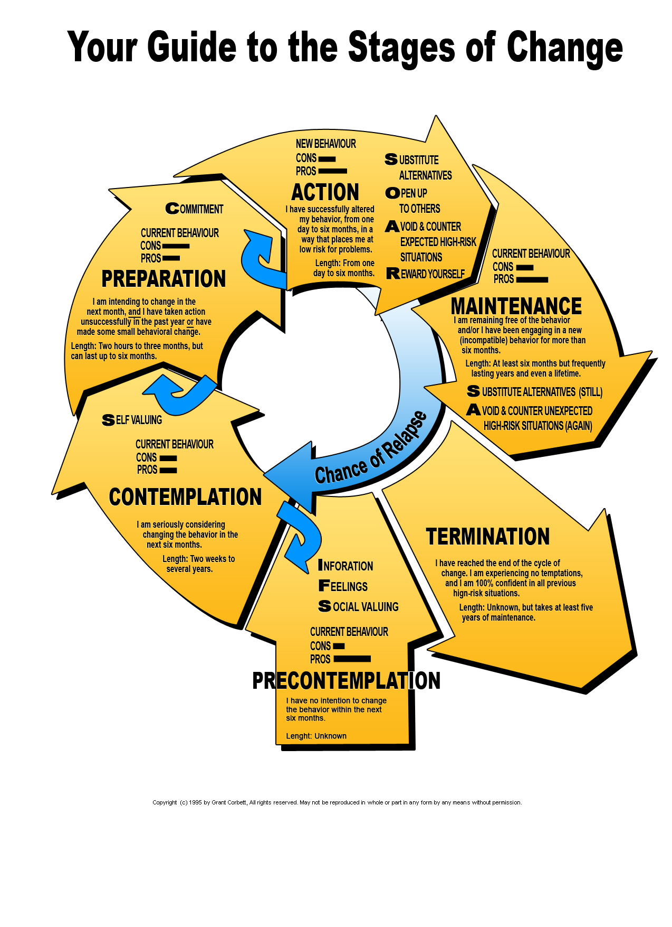

Slide 27
Recovery Tool Box for those supporting people
Don’t Panic
Establish rapport and trust
Validate the function of the behaviour
Agree on the direction (reduce harm, change amount, stop completely) needs to be driven by the person (person centered

Slide 28
continued
Don’t rush the person
Create a space to explore all aspects of change
Explore costs and benefits of change
Normalize ambivalence
Encouraging clients to openly clarify and state their attraction to substances

Slide 29

What does not (Cons)
What works
(Pros)
Adapted to support MI

Slide 30
Encourage clients to openly state their concerns about use.

Slide 31



Happy | Monday | Tuesday | Wednesday | Thursday | Friday | What happened?
Silly
Sick Yuck
Angry
sad
scarred

Slide 32
Questions?
What would happen if you stopped using?
What do you think you will do ?
Adapt questions and support with visuals
Active learning mediums.
Portable tools

Slide 33
First | Then

Slide 34
Where do we go from here ?

Slide 35
Place next steps on a visual key chain.
Power cards

Slide 36



Safe Limit Reminder
Call taxi Reminder
10:30 am

Slide 37
How would you like things to turn out now for you, ideally
What would you like to do every day?
Adaptation
What would your best day be like?
Source: Miller and Rollnick, 1991

Slide 38
Strength Based approach
Acknowledge the courage of their decision to try something different. Adaptation: Point out strengths observed during the session as they are presented. Frequently and concretely.
Offer hope that help is available Adaptation: be concrete who to call
Make recommendations for reduction in use, develop a plan.
Identify support system

Slide 39
Keep a record of success
Day/Evening record of success
Date/shift

Slide 40
continued
Celebrate
Acknowledge and validate the changes being made
Teach social skills
Teach budgeting skills
Teach emotional regulation skills
Change living environment
Teach coping skills with respect to triggers.

Slide 41


Slide 42
Questions

