Slide 1

Primary Care Guidelines & Tools for Adults with Intellectual / Developmental Disabilities (I/DD) – An Introduction for Post-Secondary Students
Angie Gonzales, RN MN
Health Care Facilitator
Toronto Network of Specialized Care
Surrey Place Centre
March 15, 2013 Videoconference
Those joining via webinar can e-mail questions to: megan.primeau@surreyplace.on.ca

Slide 2
Community Networks of Specialized Care (CNSC)
  Link specialized services and professionals to pool their expertise to treat and support adults who have developmental disabilities and mental health needs and/or challenging behaviours (ie. dual diagnosis) in the communities where they live.
  Bring together people from a variety of sectors including developmental services, health, research, education and justice in a common goal of improving the coordination, access and quality of services for these individuals who have complex needs.

Slide 3
Handouts and Questions
Copies of handouts and video archives for this and other videoconferencing events can be found under the “Videoconferencing” tab at http://www.communitynetworks.ca/
Those joining via webinar can e-mail questions to: megan.primeau@surreyplace.on.ca

Slide 4

Learning Outcomes:
Participants will be able to:
Be knowledgeable about the Canadian primary care consensus guidelines
Discuss disparities & physical health considerations specific to persons with I/DD
Be knowledgeable about developmental services resources
Apply evidence from DD primary care guidelines & tools to a case study

Slide 5

Definition of ‘Primary Care’
The 1st level of contact with the medical care system provided primary care providers (e.g. office visits, emergency room visits and house calls) operating inside the larger context of primary health care
In our current system, primary care is provided by family physicians, nurse practitioners, nurses, pharmacists, physiotherapists and dentists, among others
Reference: http://www.toolkit.cfpc.ca/en/glossary.php

Slide 6
Definition of Intellectual Disability
The American Psychiatric Association defined intellectual disabilities as significantly below average intellectual & adaptive functioning with onset before age 18 years (DSM-IV-TR, 2000)
General intellectual functioning is measured by an individually administered standardized test of intelligence that results in an overall intelligence quotient (IQ) for the individual
Criteria is an IQ score of 70 or below
Adaptive behavior refers to the effectiveness with which an individual meets demands of daily living for individuals of his/her age & cultural group, e.g. skills for eating & dressing, communication, socialization & responsibility
Reference: http://thenadd.org/resources/information-on-dual-diagnosis

Slide 7
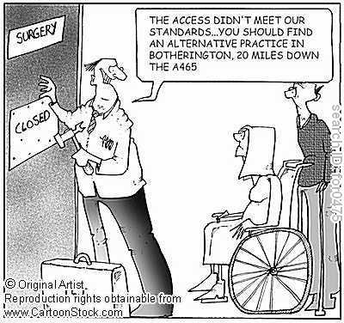
‘Special Needs’ & Access to Primary Care
Sometimes we face barriers in access to mainstream primary care services due to ‘special needs.’ Mainstream programs, approaches, environments, etc. may not be deemed appropriate for individuals with I/DD.

Slide 8
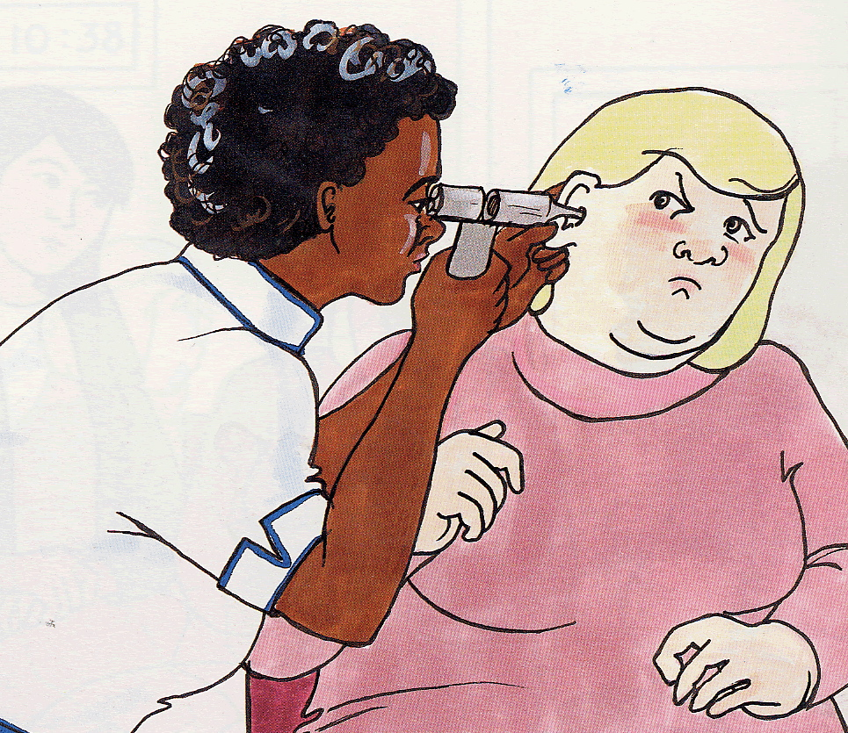
What health care challenges & barriers do adults with DD often have?
Limited reading & writing ability, limited knowledge of health, self-care & health resources
Problems understanding complex information e.g., a doctor’s explanation about tests or illnesses, unless given in everyday language
Problems with tests & procedures:
  Fear and anxiety about needles, tests & medical exams
Difficulty communicating

Slide 9

Challenging issues :
From Survey of FP’s
Problems communicating, including consent
Complicated medical issues
Aggression & other “behavioural problems”
Finding enough time
Lack of educational materials to help patients understand what the clinician is doing
  Why & how they can contribute to their health
Lack of community resources for psychosocial rehabilitation

Slide 10
Health Inequities & Health Care for People with DD: Canadian Context
Canadian research indicates that individuals with developmental disability are more likely to be hospitalized for ‘ambulatory care sensitive conditions’ than others without developmental disability who also have those conditions (Balogh, 2010)
  Indicator of poor primary care
“Disparities in primary care exist between adults with developmental disability & the general population. The former often have poorer health, increased morbidity, & earlier mortality. Assessments that attend to the specific health issues of adults with developmental disability can improve their primary care” (DDPCI guidelines)
Developmental disability is taught to varying degrees in Canadian Medical Schools

Slide 11
Important Statistics
How many people have developmental disabilities (DD) in Ontario?
  1-3% of population
  Approx. 275,000 in Ontario
Approx 80 - 90% have DD in the “mild” range
How many people with DD have a known cause of the DD?
  < 50% have a known cause of the DD, e.g. diagnoses such as Down syndrome, Williams syndrome, Fetal Alcohol Spectrum Disorder
More medical conditions?
  2-5x more than general population
Increasingly aging population

Slide 12
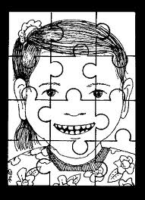
Co-morbidities
Higher rates of some health problems (e.g. seizures, CVD, dental caries & gingivitis, GERD, constipation, sensory impairments, obesity, mental health problems)
Earlier onset of some conditions (e.g. dementia)
Atypical presentation/symptoms (e.g. dysphagia, GERD or pain)
Complicating factors (e.g. multiple & long-term medications, vulnerabilities)

Slide 13
Leading Causes of Death due to Illness
General Population | People with Developmental Disability
1. Cancer | 1. Respiratory diseases
2. Ischemic heart disease | 2. Heart disease due to obesity, congenital malformations, side effects of neuroleptics
3. Cerebrovascular disease | 3. Gastrointestinal diseases
Notes:
13

Slide 14
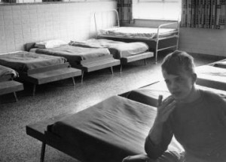

Context
Last 4 decades: closure of institutions
2005 MCSS established Community Networks of Specialized Care (CNSC)
Consensus Guidelines for the Primary Care of Adults with Developmental Disabilities first published in 2006 & 2011 to assist primary care physicians
Notes:
14

Slide 15
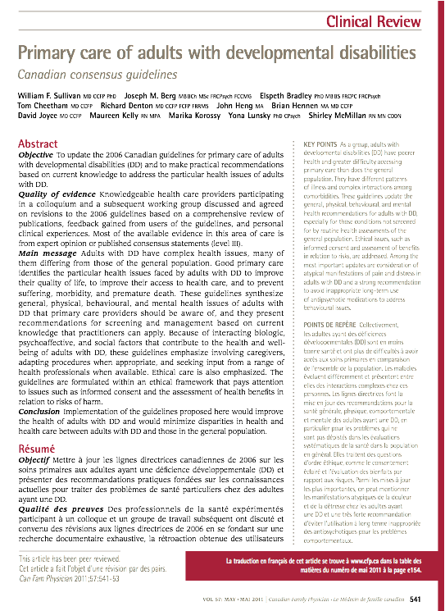
Primary Care of Adults with DD:
Canadian Consensus Guidelines 2011
Describe best practices in caring for adults with Developmental Disability
Reviewed & published in Canadian Family Physician May 2011
Available on SPC website
  http://www.surreyplace.on.ca/Primary-Care/Pages/Home.aspx

Slide 16
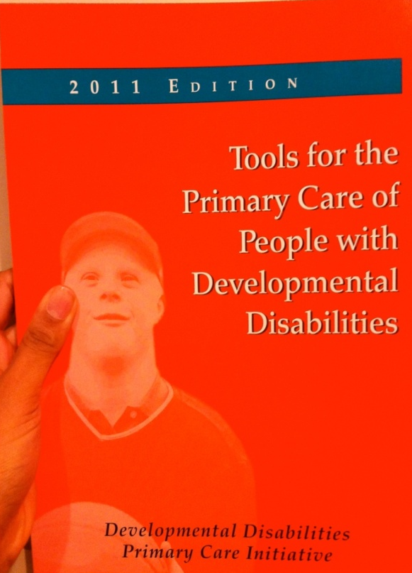
Tools for the Primary Care of People with Developmental Disabilities
Developed to assist Primary Care Providers in the “how-to” of applying the guidelines
Tools are available on Surrey Place Centre’s website
  http://www.surreyplace.on.ca/Primary-Care/Pages/Home.aspx

Slide 17
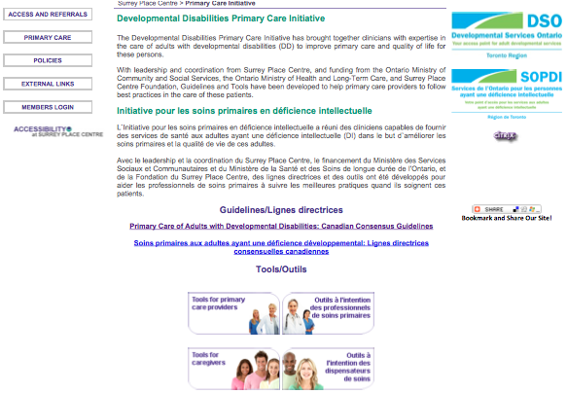
DD Primary Care Guidelines, Tools for Primary Care Providers & for Caregivers http://www.surreyplace.on.ca/Primary-Care/Pages/Home.aspx

Slide 18
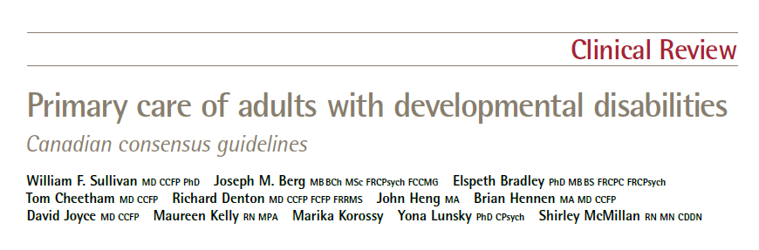



Slide 19

Canadian Consensus Guidelines for the Primary Care of Adults with DD (2011)
31 guidelines, 74 evidence-ranked recommendations:
  General issues (9)
  Physical health issues (12)
  Behavioural & mental health issues (10)

Slide 20
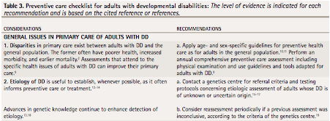
DD Primary Care Guidelines - Disparities
Guideline 1: “Disparities in primary care exist between adults with DD and the general population. The former often have poorer health, increased morbidity, and earlier mortality. Assessments that attend to the specific health issues of adults with DD can improve their primary care”
Guideline 2: “Etiology of DD is useful to establish, whenever possible, as it often informs preventative care of treatment”

Slide 21
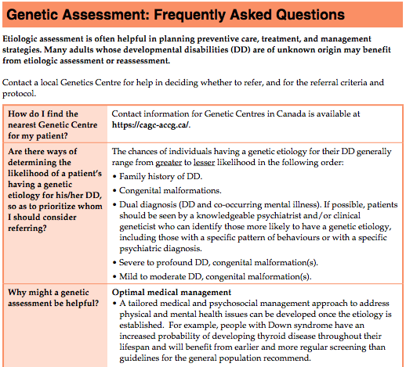

Slide 22
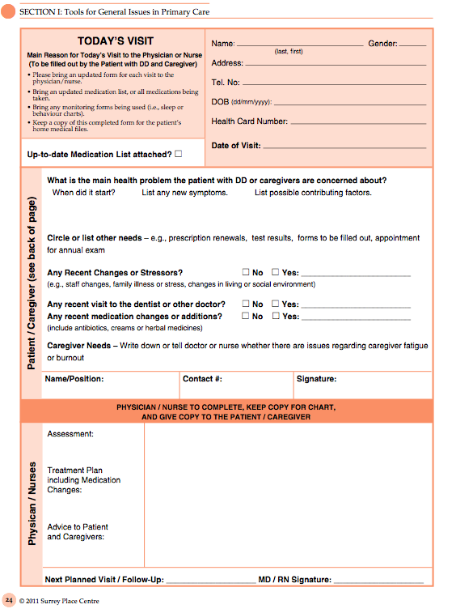
Today’s Visit Tool
Tool to help with optimizing limited time allotted for medical appointments

Slide 23
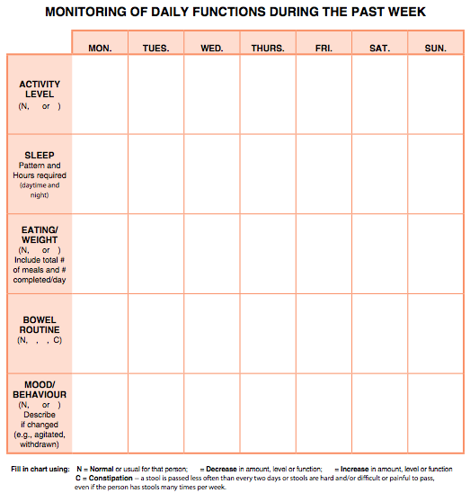

Slide 24

Examples of Tools – Health Watch Tables
  Down Syndrome
  Fragile X Syndrome
  Prader-Willi Syndrome
  Smith-Magenis Syndrome
  22q11.2 Deletion Syndrome

Slide 25
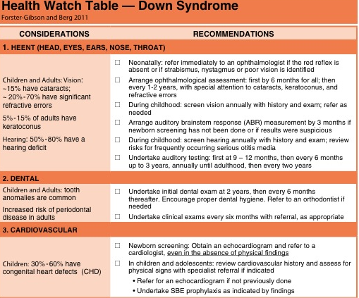
Down Syndrome HWT
http://www.surreyplace.on.ca/Documents/Down%20Syndrome.pdf

Slide 26
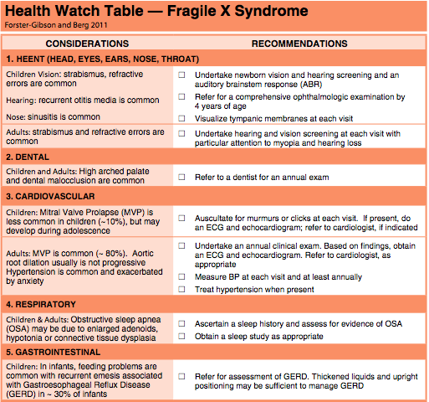
Notes:
Example of the FraX HWT
26

Slide 27
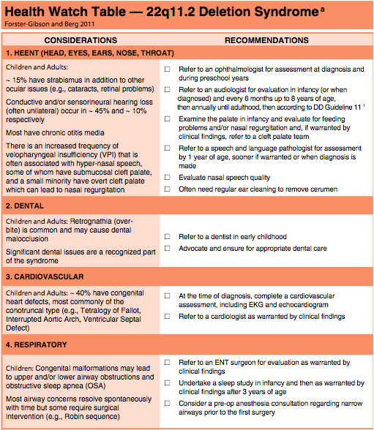

Slide 28
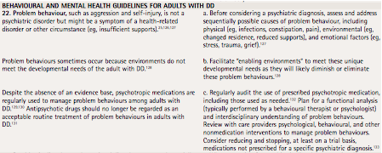
DD Primary Care Guidelines –
Problem Behaviour
Guideline 22: “Problem behaviour, such as aggression and self-injury, is not a psychiatric disorder but might be a symptom of a health-related disorder or other circumstance…”

Slide 29

Behavioral & Mental Health
A Guide to Understanding Behavioral Problems & Emotional Concerns
This guide aims to help identify the causes of behavioral problems, in order to plan for treatment and management, and prevent reoccurrence
Notes:
Tool matches behaviour guidelines

Slide 30
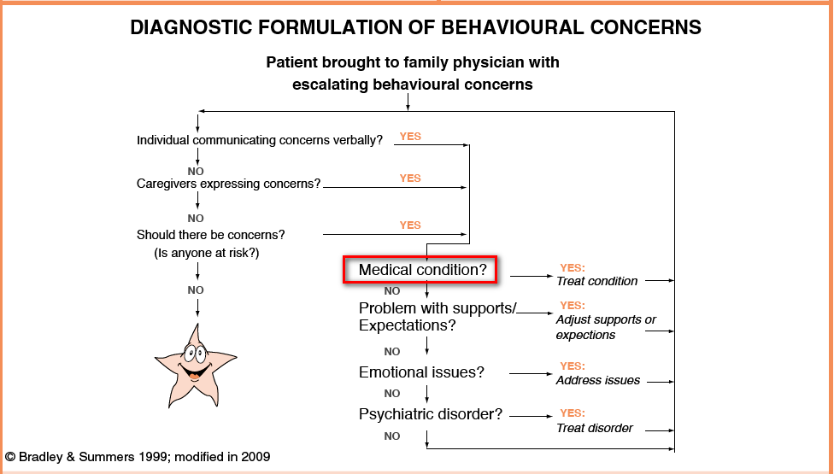
Notes:
This diagram was developed by Dr. Elspeth Bradley from SPC.
-First rule out medical causes of changes in behaviour
-Give short case example

Slide 31
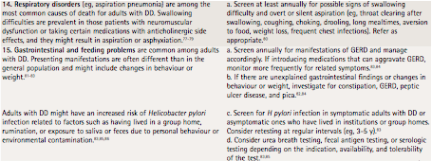
DD Primary Care Guidelines –
Physical Health
E.g. guidelines 14 & 15: “Respiratory disorders, (e.g. aspiration pneumonia) are among the most common causes of death for adults with DD…” & “Gastrointestinal and feeding problems are common among adults with DD. Presenting manifestations are often different…”

Slide 32
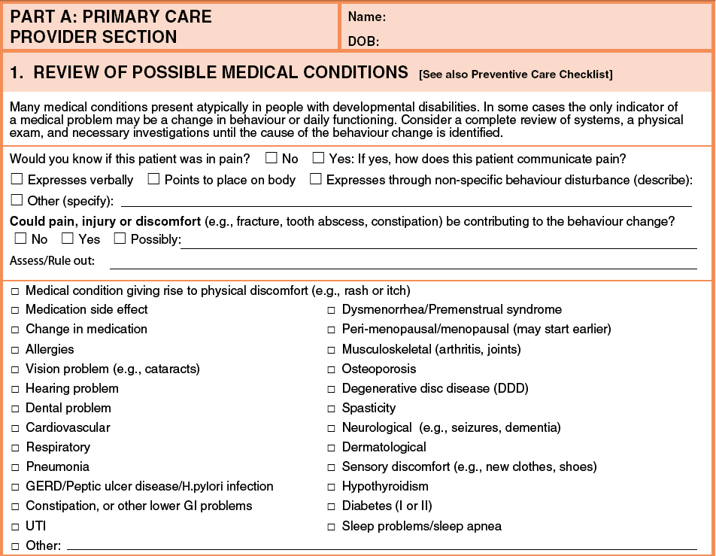

Slide 33
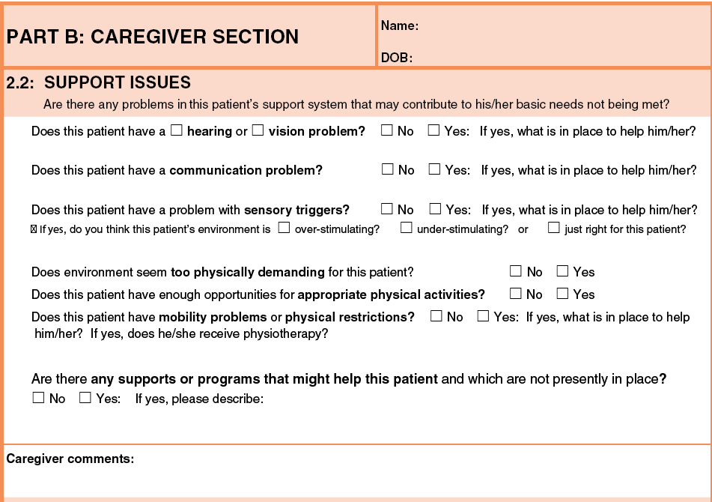

Slide 34
Understanding Adaptive Functioning
Level of Severity | IQ | Mental Age Equivalence
Mild | 55-70 | 9-12 years old
Moderate | 40-50 | 6-9 years old
Severe | 25-35 | 3-6 years old
Profound | < 25 | < 3 years old

Slide 35
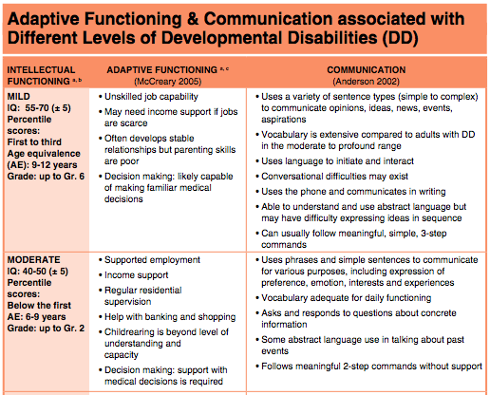
Adaptive Functioning & Communication Tool

Slide 36
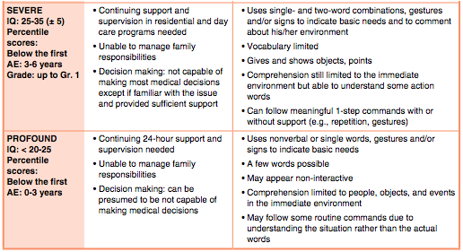
Adaptive Functioning & Communication Tool

Slide 37

Adaptive Functioning & Communication Tools
www.tdsb.on.ca

Slide 38
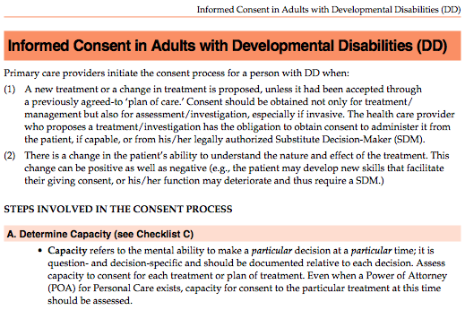
Informed Consent Tool

Slide 39
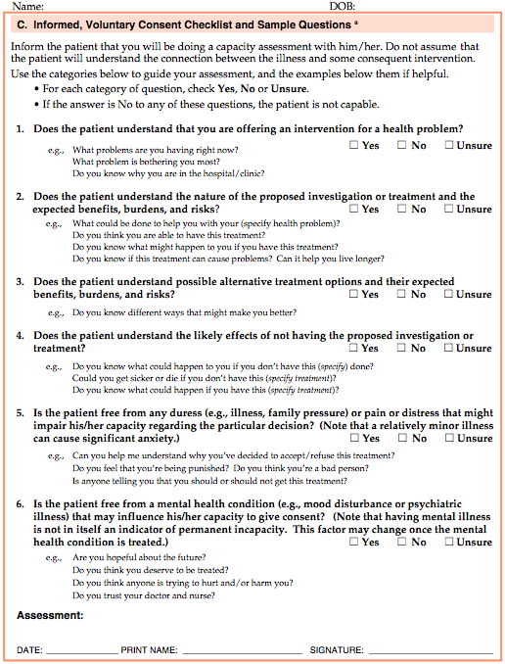

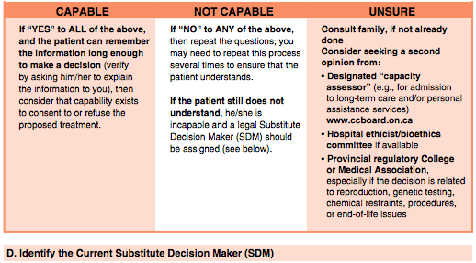
Informed Consent Tool

Slide 40

Other Tools Available Online
http://www.surreyplace.on.ca/Documents/Down%20Syndrome.pdf
Psychological Assessment: FAQs
Preventative Care Checklists
Crisis Prevention & Management Plan
Essential Information for Emergency Dept
Auditing Psychotropic Medication Therapy

Slide 41

Caregiver Monitoring Tools
Weight
Bowel Management
Menses
Sleep
Seizure Package

Slide 42
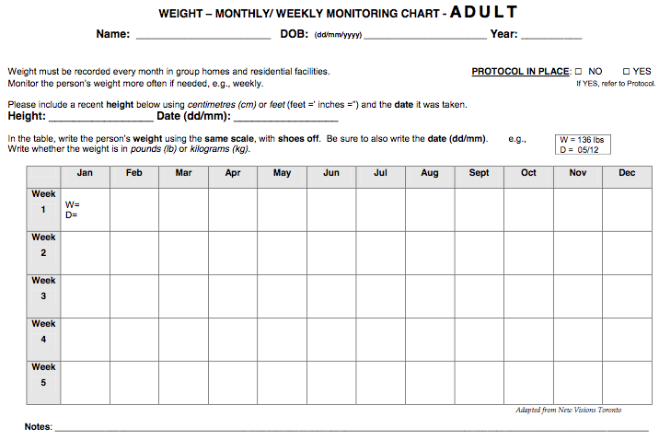
Caregiver Tools: Weight Chart

Slide 43
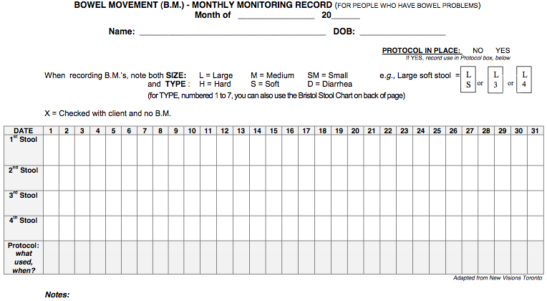
Caregiver Tools - Bowel Management

Slide 44
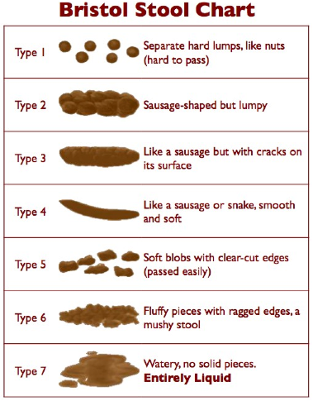
Caregiver Tools - Bowel Management

Slide 45
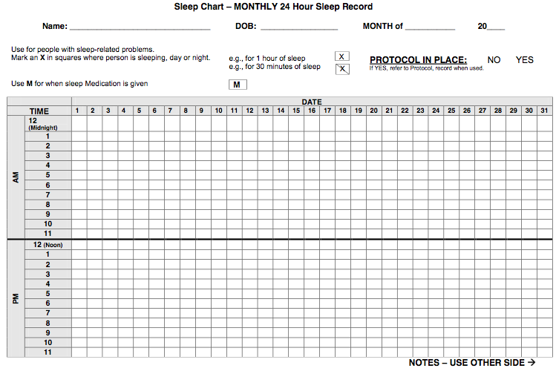
Caregiver Tools – Sleep Chart

Slide 46
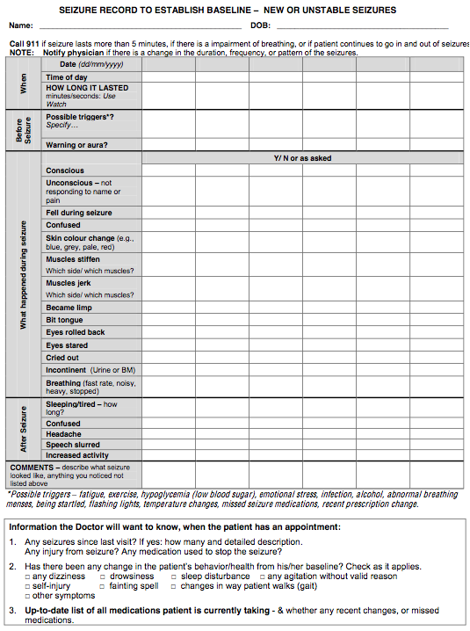
Caregiver Tools
Seizure Package
Seizure General Information
Seizure First Aid Guide
Seizure Action Plan
Seizure Resources
Seizure Tool
Tips for Caregivers
Seizure Baseline Chart
Daily Seizure Monitoring Chart
Seizure Frequency Yearly Summary Sheet

Slide 47

Autism Speaks Toolkits http://www.autismspeaks.ca/family-services/toolkits

Slide 48

Services & Resources:
DSO Toronto Region
The single point of access for all ‘new’ adults with a developmental disability to access Ministry funded adult services & supports

Slide 49
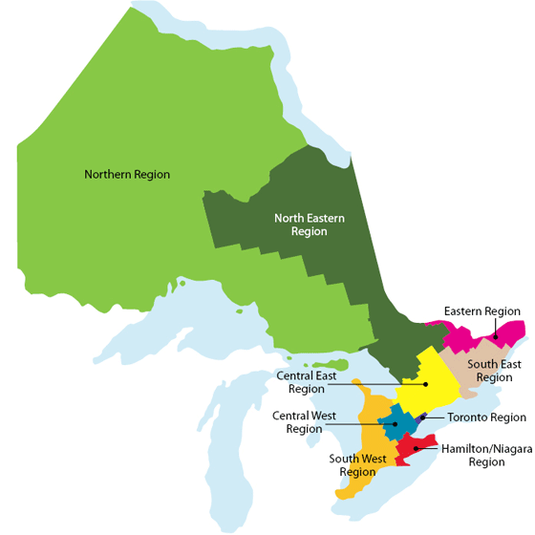

Community Networks of Specialized Care
In 2005, MCSS established 4 regions to form a provincial network of specialized care to support individuals with developmental disabilities, mental health (dual diagnosis) &/or challenging behaviours
In 2010, Health Care Facilitators (HCFs) provincially hired – 10 across Ontario

Slide 50

Toronto Network of Specialized Care
Specialized
Clinical services/supports
Case management
Crisis response & transition supports
Respite services
Residential & day treatment programs
Inpatient & outpatient hospital treatment programs
Notes:
50
50

Slide 51

Role of the Health Care Facilitator
Facilitate referrals & linkages with Family Health Teams, Community Health Centres, CCAC & Long Term Care system
Toronto region – Clinical Conferencing
Promote linkages between health care professionals
Support care providers with implementing health care planning
Identify & develop strategies for navigating existing generic health services
Support agencies & Community Network of Specialize Care partners in developing health care networks
Notes:
51

Slide 52
Case Example: Frequent ER Visitors
Paul is an 18-year-old adult with autism, severe/profound DD, seizure disorder & pica
Prescribed medications: olanzapine, valproic acid & dilantin
History of pica since childhood but has escalated in the past 6 months along with episodes of severe aggression
Paul was taken to local emergency department 6 times over the past 2 months with distress behaviours and the last 2 visits were related to ingesting vinyl gloves
For each emergency visit, he was admitted overnight or for a few days, restrained in a crisis bed and sedated with IM injections of olanzapine and haldol, then discharged when aggression subsides
What could care/service providers advocate for?

Slide 53
Case Example – Access Barriers
Laura is a 52-year-old woman with mild/moderate DD of unknown etiology, anorexia nervosa & query dementia
Her BMI is 13.8 kg/m²
She lived in semi-independent living residential program for the past 5 years but caregivers notices a more severe decline in weight and mental health in the past 2 years
Caregivers take her to Emergency department but she is admitted only for re-hydration then discharged next day
Her family physician referred her to hospital eating disorders programs but the referral is declined due to DD
CCAC referral for dietician is also declined with response being that she should be referred to an eating disorders program
What could care/service providers advocate for?

Slide 54

Your Examples?

Slide 55
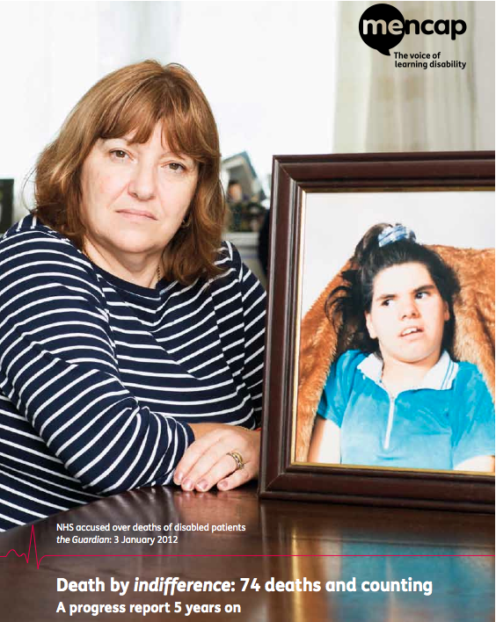
“Death By Indifference”
http://www.mencap.org.uk/campaigns/take-action/death-indifference

Slide 56

Questions or Comments?

Slide 57

Resources
Surrey Place Centre website
  www.surreyplace.on.ca
DSO Toronto Region Website
- http://www.surreyplace.on.ca/dso/index.html
Community Networks of Specialized Care
  http://www.community-networks.ca

Slide 58

Evaluation
Please complete the survey here https://www.surveymonkey.com/s/6DBDJ2S to provide additional feedback.
If you have an app for a QR reader on your smartphone, use the following code to complete the evaluation right now

Slide 59
Educational Opportunity
Please also check out information about the upcoming Heath and Wellbeing in Developmental Disabilities conference at http://www.healthandwellbeingindd.ca/; the conference welcomes abstract/poster submissions from students (due by Mar 31, 2013) and offers a reduced registration fee for students.

Slide 60

Concluding Remarks
Notes:
Conclude workshop by sharing success stories & reviewing learning outcomes

Slide 61

Thank You!
Contact:
Angie Gonzales
angela.gonzales@surreyplace.on.ca
Phone 416.925.5141 ext. 3114

Slide 62
Selected Primary Care References
Bradley, E. and Hollins, S. (2010). Assessment of patients with intellectual disabilities. Psychiatric Clinical Skills. Toronto: Centre for Addiction and Mental Health.
Balogh, R., Brownell, M., Ouellette-Kuntz, H., & Colantonio, A. (2010). Hospitalisation rates for ambulatory care sensitive conditions for persons with and without an intellectual disability-a population perspective. Journal of Intellectual Disability Research, 54, (9), pp. 820–832.
Lunsky, Y., Lin, E., Balogh, R., Klein-Geltink, J., Wilton, A.S., & Kurdyak, P. (2012.) Emergency department visits and use of outpatient physician services by adults with developmental disability and psychiatric disorder. Can J Psychiatry, 57, (10), pp. 601-607.

Slide 63
Selected Primary Care References
Lunsky, Y., Balogh, R., & Cairney, J. Predictors of emergency department visits by persons with intellectual disability experiencing a psychiatric crisis. (2012). Psychiatr Serv., 63, (3), pp. 287-290
Ouellette-Kuntz, H. (2005). Understanding health disparities and inequities faced by individuals with intellectual disabilities. Journal of Applied Research in Intellectual Disabilities, 18, (2), pp. 113-121.
Primary Care of Adults with Developmental Disabilities Canadian Consensus Guidelines (and tools): http://www.surreyplace.on.ca/Primary-Care/Pages/Home.aspx
Van, S.L. (2009). Health persons with intellectual disabilities in an inclusive society. Journal of Police & Practice in Intellectual Disabilities, 6, (2), pp. 77-80.

